Slide 1

A Guide for Employees
Approaching Retirement

Slide 2
Agenda
Federal Employees Retirement System (FERS)
Civil Service Retirement System (CSRS)
Postal Service Health Benefits (PSHB)
Federal Employees Group Life Insurance (FEGLI)

Slide 3
Agenda cont.
Thrift Savings Plan (TSP)
Social Security Administration (SSA)
Other considerations
Applying
Post-retirement info

Slide 4


Federal Employees Retirement System
(FERS)
Applied to new hires on and after Jan. 1, 1984
Three components
  FERS Basic Benefit – a defined benefit plan
    Special Annuity Supplement
  Social Security
  Thrift Savings Plan – a defined contribution plan
Notes:
When Congress created FERS they intended for it to be in parity with CSRS (taking into account Social Security and TSP).
Defined benefit plans have become rare.

Slide 5

NALC Career Employment Statistics
Nov. 2024:
  FERS 178,528 99.3%
  CSRS 1,288 0.7%
  Total 179,816
Notes:
Good time to see if any CSRS employees are in the room.

Slide 6

Cost
FERS is funded through employer and employee contributions. Employee contributes:
  FERS – Hired before Jan.1 2013 – 0.8%
  FERS RAE (Revised Annuity Employees) – Hired in 2013 – 3.1%
  FERS FRAE (Further Revised Annuity Employees) – Hired 2014 or later – 4.4%
Notes:
Emphasize that we are talking about FERS now.
Even with increases to employee contributions, the pension is still a good benefit.
Employer contributions vary. Currently, it’s approximately 17%.

Slide 7

Types of Retirement
Voluntary (regular / immediate)
  Based on age and service
Disability
Early (MRA + 10)
  Minimum retirement age with 10 years of service
  Can be postponed to reduce or eliminate age reduction
Deferred

Slide 8
Types of Retirement
Alternative Form of Annuity (AFA)
  Life-threatening affliction or other critical medical condition
Early Voluntary Retirement
  Due to a reduction-in-force (RIF)
Phased
  Not currently available to USPS employees
Notes:
Alternative Form of Annuity provides an option for those with a life-threatening affliction. The annuity will be permanently reduced and they will receive a lump-sum payment of their retirement contributions. If married the spouse will need to consent to the election.
https://www.opm.gov/retirement-center/publications-forms/pamphlets/ri38-123.pdf
The Postal Service has stated it will not implement phased retirement. Phased Retirement is a human resources tool that allows full-time employees to work part-time schedules while beginning to draw retirement benefits. This tool will allow managers to better provide unique mentoring opportunities for employees while increasing access to the decades of institutional knowledge and experience that retirees can provide.

Slide 9

Voluntary Retirement
This seminar focuses on voluntary retirement or “regular” retirement based on age and service that starts immediately after separation.
NALC members considering MRA + 10 (early), disability, or other types of retirement should obtain direct one-on-one advice from a branch officer, their NBA office, or the NALC HQ retirement department.

Slide 10
Minimum Retirement Age
(MRA)
If you were born: | Your MRA is:
Before 1948 | 55
1948 | 55 and 2 months
1949 | 55 and 4 months
1950 | 55 and 6 months
1951 | 55 and 8 months
1952 | 55 and 10 months
Notes:
FERS Minimum retirement age depends on the year of birth.

Slide 11
Minimum Retirement Age
(MRA)
If you were born: | Your MRA is:
1953 through 1964 | 56
1965 | 56 and 2 months
1966 | 56 and 4 months
1967 | 56 and 6 months
1968 | 56 and 8 months
1969 | 56 and 10 months
1970 and after | 57

Slide 12
When will I be eligible to retire?
Voluntary (optional/immediate) annuity eligibility:
Age | Years of Service
62 | 5
60 | 20
Minimum Retirement Age (MRA) | 30
Notes:
FERS Minimum Retirement Age (MRA) should not be confused with Social Security Full Retirement Age (FRA).

Slide 13
Creditable Service for Eligibility
For eligibility purposes, combine:
  FERS service
  Military service (if deposit made)
  Non-career service (if deposit made)
  Subtract LWOP in excess of six months in a calendar year
Notes:
Creditable Service for eligibility can be different than creditable service when calculating the annuity amount. It is important that the two are not confused.

Slide 14
Creditable Service
Sick Leave
Sick leave balance at retirement is added to the length of service to calculate the amount of an immediate annuity
Unused sick leave counts towards annuity calculation but does not count towards eligibility
Potential pitfall – retiring before eligibility because you incorrectly counted sick leave could result in large and permanent reduction to annuity.

Slide 15
Creditable Service
LWOP
Cumulative leave without pay (LWOP) in excess of 6 months in a calendar year is not credited.
In other words, the first six months of cumulative leave without pay per calendar year is credited.
Exceptions: All LWOP is credited if due to:
  an on-the-job injury and wage loss compensation was paid by OWCP
  full-time union official employment and union pays employer contributions
  military furlough

Slide 16

Crediting Military Service
Must be:
  Active duty
  Discharged under honorable conditions
Military retired pay must be waived unless it is based on:
  A disability incurred in combat, or
  A reserve component of the Armed forces
National Guard service is creditable only in limited circumstances

Slide 17
Crediting Military Service
A deposit must be made for all military service performed after 1956 to receive credit for eligibility or towards annuity computation.
Deposit must be completed prior to separation.
Intermittent periods of military active duty, such as reservist activation, will be deducted from total service at retirement if no deposit was made.
  Beware: such intermittent periods of service won’t be flagged on your annuity estimate; without forewarning, this service time will be eliminated from your service record at retirement, when it’s already too late to make deposit.
Notes:
Unlike deposits for non-career civilian service, military deposits MUST be completed prior to separation for credit.

Slide 18
Crediting Military Service
Military deposit equals 3% of base military pay plus interest
  Interest does not start to accrue for the first two years of civilian service
Alternative method under USERRA
  Amount of deposit before interest is limited to the amount of civilian retirement deductions which would have been withheld
Notes:
Interest that starts to accrue for the third year does not become effective until the end of the year, so technically if the deposit is completed prior to the end of year 3 there will be no interest.
In any case, the recommendation is to make sure new hires are aware of making a deposit for military service if applicable.
https://www.opm.gov/retirement-center/benefits-officers-center/webcast-presentations/military-deposits.pdf

Slide 19
Making a Deposit for
Military Service
Call USPS Human Resources Shared Service Center (HRSSC)
  (877) 477- 3273 (option 5)
Complete SF 3108 Application to Make Service Credit Payment
Submit completed form with DD 214 or equivalent record to verify the service, as well as military earnings statements
Remember – the full deposit must be completed prior to separation
Notes:
They can begin the process of making a deposit. Then compare the benefits to the cost to make a fully informed decision.

Slide 20
Military Deposit
Deposit for military time, unlike deposit for prior non-career federal service, must be completed prior to retirement.

Slide 21

Crediting Non-Career Federal Service
Service prior to 1989
  Credited only if deposit is made
Service on or after Jan. 1, 1989
  Not creditable without legislative action
    https://www.nalc.org/government-affairs
Cost – 1.3% of basic pay of the non-career service, plus interest
Notes:
Another reason to participate in politics: 118th Congress Federal Retirement Fairness Act (H.R. 5995) would have allowed deposits for civilian service after 1988 if it had passed into law.
https://www.nalc.org/government-affairs/legislative-activities/document/Federal-Retirement-Fairness-Act-2023.pdf
A note about the QR Code: participants can use a smartphone camera to access the link. Presenter may want to inform the audience how to use the QR code if necessary. These QR codes and links are also available on the handout.

Slide 22
Making a Deposit for Non-Career Service
Call USPS HRSSC: (877) 477- 3273 (option 5)
Complete SF 3108 Application to Make Service Credit Payment
Deposit can be made to USPS prior to separation or directly to OPM after separation.

Slide 23

Annuity Computation
Annuity Computation – Multiply:
  Years of Service
  High-3 Average Salary
  Factor (1.0% or 1.1%)
Notes:
This serves as an overview. We will explain each of these variables.

Slide 24
Annuity Computation
Length of Service
Years of Service – for annuity computation purposes
  Years under FERS, PLUS:
    military service (if deposit made)
    non-career federal service (if deposit made)
    banked sick leave
  MINUS LWOP in excess of six months in a calendar year
Notes:
RED FLAG: Letter Carriers with military reserve time that was not active service should be sure to verify their service credit on Form 3107-1 Certified Summary of Federal Service prior to retiring.
Military Reserve service during Weekly or Biweekly Training Periods is not active duty and therefore not creditable for CSRS/FERS purposes.
While the weekly and biweekly training sessions are reserve duty and not creditable, the annual 15-day training camp or cruise which reservists are called upon to attend (and for which they receive pay and allowances) is active duty and, therefore, creditable.
The Postal Service has on occasion not updated service history to deduct un-creditable military reserve time until letter carriers have retired.

Slide 25

Annuity Computation
Length of Service
Years of service
  Length of service is rounded down to the nearest month. Days short of a month (30 days) are dropped from the total.
  Example: 30 years, 2 months, and 17 days would result in 30 years and 2 months of service for computational purposes.

Slide 26

Annuity Computation
High-3 Average Salary
Highest three consecutive years of pay
  Typically, last three years for letter carriers
Base pay only
  Does not include overtime, night differential, bonuses
Nonpay status while on OWCP, union official, and periods of LWOP less than 6 months in a calendar year count
  Payrate found on PS Form 50
Notes:
Essentially, if the service is creditable for length of service, it is creditable towards your High-3 Average Salary.
High-3 average salary computations are based on periods of creditable service. Thus, periods of nonpay status of 6 months or less in a calendar year that fall within an employee’s average salary period are included in the calculation of the average salary using the rate of basic pay in effect during the period of nonpay status. For example, if a full-time employee whose annual rate of basic pay is $85,000 per year is placed in nonpay status for 3 months, that 3-month period would be credited in the average salary calculation using the $85,000 basic pay rate. (If the rate of basic pay changed to $86,500 per year after 2 months of the nonpay period, the first 2 months of the nonpay period would be credited in the average salary calculation using the $85,000 basic pay rate and the last month of the nonpay period would be credited in the average salary calculation using the $86,500 basic pay rate.)
https://www.opm.gov/policy-data-oversight/pay-leave/leave-administration/fact-sheets/effect-of-extended-leave-without-pay-lwop-or-other-nonpay-status-on-federal-benefits-and-programs/

Slide 27
Annuity Computation
High-3 Average Salary
Effective Date | Type of Increase | Amount
Feb. 26, 2022 | COLA | $1,331
Aug. 27, 2022 | COLA | $2,455
Nov. 19, 2022 | General Wage Increase | 1.3%
Mar. 11, 2023 | COLA | $208
Notes:
For years 2021-2024 prior to 2023 National Agreement

Slide 28
Annuity Computation
High-3 Average Salary
From | To | Years | Months | Days | Annual Rate | Gross Pay
3/11/2023 | 12/31/2024 | 1 | 9 | 20 | $75,299 | $136,363
11/19/2022 | 3/10/2023 | 0 | 3 | 19 | $75,091 | $22,836
8/27/2022 | 11/18/2022 | 0 | 2 | 22 | $73,802 | $16,782
2/26/2022 | 8/26/2022 | 0 | 6 | 0 | $71,347 | $35,380
1/1/2022 | 2/25/2022 | 0 | 1 | 24 | $70,016 | $10,550
3-Year Average Salary $73,971
Notes:
FOR DEMONSTRATION PURPOSES ONLY.

Slide 29
Annuity Computation
Factor
1.0% is the default factor
1.1% if at least age 62 with 20 or more years of service at retirement
  This amounts to a 10% increase in the annuity
  A trade off to retiring before 62 and receiving the Special Annuity Supplement
  Potential pitfall: retiring right before age 62 with over 20 years of service. You don’t get the extra 10% and you minimize receipt of the Special Annuity Supplement.

Slide 30
Annuity Computation
Example
30 years total service, age 59
  1% x 30 years x High-3 = 30% of High-3 Average Salary
30 years total service, age 62
  1.1% x 30 years x High-3 = 33% of High-3 Average Salary

Slide 31

Early (MRA + 10)
Employee has MRA and at least 10 years of service but less than 30 (also does not have age 60 with ≥ 20 years of service) and begins receiving annuity before age 62.
Age reduction of 5% for each full year under age 62. PERMANENT.
NO Special Annuity Supplement.
Notes:
Age reduction – each month under 62 is 5/12 of a percent reduction.

Slide 32
Special Annuity Supplement
Intended to substitute for the Social Security part of the total FERS benefit until age 62
Paid by OPM, not Social Security
Subject to earnings test
No Cost-of-Living Adjustments
Ends at age 62 whether you start Social Security or not
Notes:
The supplement is an estimate of the amount of Social Security benefits earned during FERS civilian service.
The supplement ends on the earlier of the last day of the month in which the retiree becomes age 62 or the last day of the month before the first month for which the retiree would, upon proper application, be entitled to Social Security benefits.
https://www.opm.gov/retirement-center/publications-forms/csrsfers-handbook/c051.pdf Page 5

Slide 33
Special Annuity Supplement
Eligibility
  Must have at least one full calendar year of FERS service
  Retiring voluntarily on an immediate annuity which is not reduced for age:
    MRA with at least 30 years of service
    Age 60 with at least 20 years of service
  Not eligible if retiring age 62 or later
Notes:
Not eligible: Disability retirees, individuals retiring under MRA+10, individuals who are eligible only for a deferred annuity, individuals retiring age 62 or later.

Slide 34
Special Annuity Supplement
Earnings Test
  Earnings are wages, including self-employment.
    Does not include investment gains, interest, pensions, TSP withdrawals, etc.
  Must report earnings each year to OPM.
  Exempt amount subject to change each year. Aligns with Social Security earnings limitation. Supplement is reduced by $1 for each $2 earned above the limit.
  2025 earnings limit is $23,400.
Notes:
[2025] Supplement would be reduced to zero when earnings are $70,200 or greater. https://www.ssa.gov/oact/cola/rtea.html

Slide 35
Special Annuity Supplement
Request an annuity estimate from the Postal Service (HRSSC)
  Remember, this is just an estimate. OPM will determine exact amount upon retirement.
Notes:
The Retirement Department often receives calls from members where the estimate was around $100 too high. If retiring in December, choose the 31st because only earnings for the full calendar year (from 01/01 to 12/31) will be included in your earnings history when calculating the Supplement. www.opm.gov/retirement-center/publications-forms/csrsfers-handbook/c051.pdf (page 6)

Slide 36

Maximum Annuity
There is no maximum annuity under FERS

Slide 37
Survivor Annuity
Annuity will be reduced to provide a survivor annuity if:
  Electing a survivor annuity for a spouse
  A former spouse is entitled to a survivor annuity based on a valid court order
  Electing to provide an insurable interest annuity
Important: a surviving spouse can continue PSHB coverage after an annuitant’s death ONLY if a survivor annuity election was made and the spouse was actively covered at the time of death.
Notes:
OPM sometimes takes months to begin survivor annuity. Retirees may want to ensure some savings are set aside to help the survivor bridge the gap.
https://www.opm.gov/support/retirement/faq/survivor-benefits/

Slide 38
Survivor Annuity
Cost
  Full survivor annuity costs 10% of annuity
    Provides a survivor annuity of 50%
  Partial survivor annuity costs 5% of annuity
    Provides a survivor annuity of 25%

Slide 39
Insurable Interest Annuity
Insurable interest is an insurance term which applies to someone who would reasonably expect to derive financial benefit from your continued life.
It is presumed to exist if you name as beneficiary of the insurable interest, any of the following individuals:
  a spouse; a blood or adopted relative closer than first cousins; an ex-spouse; a person to whom you are engaged to be married; or a person with whom you are living in a relationship that would constitute a common-law marriage in a jurisdiction that recognizes common-law marriages.

Slide 40
Insurable Interest Annuity
If insurable interest annuity is for a person not just listed, an affidavit is required to provide additional information about relationship, and financial dependency.
Cost increases based on age difference. From 10% annuity reduction to 40% when named person is 30 or more years younger.
Notes:
For more info: https://www.opm.gov/faq/retire/What-is-an-insurable-interest-survivor-benefit-election.ashx

Slide 41
Death of an Active Employee
If employee has at least 10 years of creditable service (18 months of which being civilian service) and died while subject to FERS deductions, a survivor annuity of 50% is payable if:
  Married for at least 9 months, or
  The employee’s death was accidental, or
  There was a child born of the marriage
Notes:
Providing this information so that no one feels obligated to retire to ensure a survivor annuity.

Slide 42
Cost of Living Adjustments
COLAs
Not applied under age 62
  Exception for disability and survivor annuitants
The first COLA is prorated
  However, annuitants that are not eligible to receive a COLA during their first year or more will receive the full amount after becoming eligible.
Notes:
If an employee retires at 61 years and 1 month old and are 62 by December when the COLA kicks in, they will get the PRORATED amount (ineligible for less than 1 year).
If an employee retires at 60 years and are 62 by December when the COLA kicks in, they will get the FULL COLA (was ineligible for 1 year or more).

Slide 43
Cost of Living Adjustments
If the change in the CPI-W is: | The COLA equals:
0 – 2 % | The CPI-W increase
2 – 3 % | 2.0 %
Greater than 3 % | CPI-W increase minus 1%
Notes:
If an employee retires at 61 years and 1 month old and are 62 by December when the COLA kicks in, they will get the PRORATED amount (ineligible for less than 1 year).
If an employee retires at 60 years and are 62 by December when the COLA kicks in, they will get the FULL COLA (was ineligible for 1 year or more).

Slide 44
Enhanced Annuity
Extra benefit for those injured on the job and receiving wage loss compensation (WLC) for at least two months total
  While on WLC cannot contribute to Social Security or Thrift Savings Plan
  Law passed in 2003 to offset these losses

Slide 45
Enhanced Annuity
Must have at least two months of cumulative LWOP while receiving WLC
Continuation of Pay not included (still making TSP and Social Security contributions)
No action required to receive the enhanced annuity
  Should be automatic and will be built into gross annuity

Slide 46
Enhanced Annuity
Provides an additional one (1) percent per year towards annuity
Example: 13 months of LWOP while receiving WLC is 1 and 1/12 or 1.083 percent in addition to the regular annuity computation
Applies to FERS only

Slide 47

Health Benefits

Slide 48

Postal Service Health Benefits
Information from the Office of Personnel Management
www.opm.gov
  Plan brochures
  Comparison tools
  Questions & Answers

Slide 49

Postal Service Health Benefits
The Postal Service Health Benefits (PSHB) Program started Jan. 1, 2025
PSHB is a subset of the Federal Employees Health Benefit (FEHB) Program

Slide 50
Postal Service Health Benefits
In order to carry your PSHB coverage into retirement, you must be eligible to retire on an immediate annuity (including the FERS MRA + 10 retirement); and
5-year rule: You must have been continuously enrolled (or covered as a family member) in any PSHB/FEHB plan(s) for the 5 years of service immediately before the date your annuity starts
  or for the full period(s) of service since your first opportunity to enroll, if less than 5 years
Notes:
If one is eligible for an immediate annuity but postpones the start of their benefits to lower the age reduction penalty, they can get back into PSHB when their annuity commences.

Slide 51
Postal Service Health Benefits
The 5-year requirement period can include the following:
  the time you are covered as a family member under another person's FEHB/PSHB enrollment; or
  the time you are covered under the Uniformed Services Health Benefits Program (also known as TRICARE) as long as you were covered under a FEHB/PSHB enrollment at the time of your retirement.
NOTE: a surviving spouse can continue PSHB coverage after an annuitant’s death only if a survivor election was made and the spouse was actively covered at the time of death.
Notes:
Important to point out that the surviving spouse must receive a survivor annuity to continue PSHB coverage. Some people elect not to leave a survivor annuity without realizing the health insurance consequences.

Slide 52

Postal Service Health Benefits
Deferred Retirement
  If you separated from Federal service before you could retire you are not eligible to enroll in FEHB when you start to receive your deferred annuity.

Slide 53

Postal Service Health Benefits
Postponed Retirement under FERS
  If you are eligible for an immediate retirement and otherwise eligible to continue coverage into retirement, you will be eligible to reenroll for health benefits and life insurance coverage when you begin to receive your postponed annuity.

Slide 54
Postal Service Health Benefits
Most letter carriers maintain PSHB/FEHB coverage in retirement because USPS continues to pay a large share of the premiums (about 72%).
Retirees have the same open season opportunities as active employees.

Slide 55
Postal Service Health Benefits
Generally, decisions to drop FEHB coverage are irrevocable.
  Certain circumstances permit suspension (as opposed to termination) of FEHB enrollment: enrolling in Medicare Advantage, TRICARE, CHAMPVA, or Medicaid.
If you cancel your FEHB to be covered as a family member under another person’s FEHB enrollment, you are eligible to reenroll if you lose coverage under the other person’s enrollment as long as you were eligible to carry coverage at retirement. To reenroll, you must contact OPM within the period beginning 31 days before and ending 60 days after your loss of other FEHB coverage.
Notes:
There is a difference between suspending coverage (if eligible) and terminating coverage.

Slide 56
Postal Service Health Benefits
Required to enroll in Medicare Parts A and B (when eligible) if maintaining PSHB in retirement
Exceptions:
  Retired on or before Jan. 1, 2025
  Active employees at least 64 years of age as of Jan. 1, 2025
  Living outside of the United States and its territories
  Enrolled in certain health benefits through the Department of Veterans Affairs (VA) or from the Indian Health Service (IHS)
Notes:
https://www.nalc.org/news/the-postal-record/2022/july-2022/document/DRM.
There are exceptions for those enrolled in TRICARE (though TRICARE may have its own requirements to enroll in Part B), Indian Health Services, or for those that reside outside of the USA.

Slide 57
Postal Service Health Benefits
Health care is an important personal choice, consider:
  How your health insurance interacts with Part B
  Costs and benefits
  You can’t predict the future

Slide 58
Legislative Attacks on Retirement
2013 - FERS employee contributions increase from 0.8% to 3.1%
  FERS Revised Annuity Employees (FERS-RAE)
2014 - FERS employee contributions increase from 3.1% to 4.4%
  FERS Further Revised Annuity Employees (FERS-FRAE)
Many other attacks have been fought off
Notes:
Attacks on our retirement have come from both sides of the aisle. Letter carriers must stay engaged in politics to ensure we keep, and enhance, the benefits we derive through the law(s).

Slide 59
Legislative Attacks on Retirement
2018, 2019, 2020 Budget Proposals to:
  change FERS employee contributions from 4.4% to 7.5%
  change high-3 to high-5
  eliminate FERS COLA
  reduce CSRS COLA
  eliminate FERS Special Annuity Supplement
  reduce TSP G-Fund interest rate
Notes:
https://www.vox.com/2019/3/12/18261739/trump-budget-2019-federal-workers

Slide 60

[FERS pension] remains much more generous, and other means might be considered in the future to move it even closer to private plans
“
”
Notes:
Project 2025 : https://static.project2025.org/2025_MandateForLeadership_FULL.pdf

Slide 61

Social Security Fairness Act
The Social Security Fairness act was signed into law Jan. 2025
Repealed the Windfall Elimination Provision (WEP) and Government Pension Offset (GPO)
  WEP/GPO unfairly reduced benefits for CSRS annuitants and their spouses
Notes:
118th Congress 2023-2024
NALC Fact Sheet: https://www.nalc.org/government-affairs/body/2023-WEP-and-GPO-fact-sheet-1.pdf
H.R. 82: https://www.congress.gov/bill/118th-congress/house-bill/82
S. 597: https://www.congress.gov/bill/118th-congress/senate-bill/597

Slide 62
Federal Retirement Fairness Act
Not yet introduced into the 119th Congress
Make a deposit or buy back non-career service after 1988, making it creditable service under FERS.
Would give the majority of our members an opportunity to buy back their service as casuals, transitional employees (TEs) and city carrier assistants (CCAs).
Notes:
https://www.congress.gov/bill/118th-congress/house-bill/5995
NALC Fact Sheet https://www.nalc.org/government-affairs/legislative-activities/document/Federal-Retirement-Fairness-Act-2023.pdf

Slide 63

Letter Carrier Political Fund
Fight Back!
Vote
Volunteer
Contribute
Note: By making a contribution to the Letter Carrier Political Fund, you are doing so voluntarily with the understanding that your contribution is not a condition of membership in the National Association of Letter Carriers or of employment by the Postal Service, nor is it part of union dues. You have a right to refuse to contribute without any reprisal. The Letter Carrier Political Fund will use the money it receives to contribute to candidates for federal office and undertake other political spending as permitted by law. Your selection shall remain in full force and effect until canceled. Contributions to the Letter Carrier Political Fund are not deductible for federal income tax purposes. Federal law prohibits the Letter Carrier Political Fund from soliciting contributions from individuals who are not NALC members, executive and administrative staff or their families. Any contribution received from such an individual will be refunded to that contributor. Federal law requires us to use our best efforts to collect and report the name, mailing address, occupation and name of employer of individuals whose contributions exceed $200 per calendar year. Any guideline amount is merely a suggestion, and an individual is free to contribute more or less than the guideline suggests and the union will not favor or disadvantage anyone by reason of the amount of their contribution or their decision not to contribute.

Slide 64
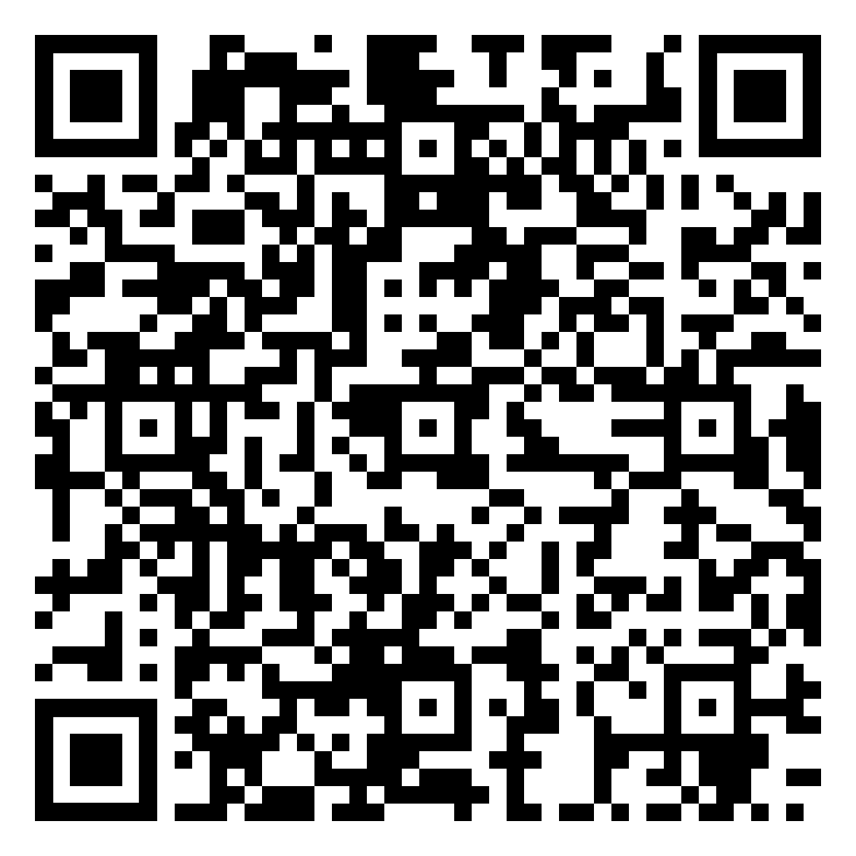
Letter Carrier Political Fund
Enroll by phone
  Call Brent Fjerestad (202) 393-4695
    Special Assistant to the President for Legislative & Political Organizing
Enroll online
  Log into OPM Services Online, click ALLOTMENTS TO ORGANIZATIONS, select Letter Carrier Political Fund
Enroll by mail – download the form in the QR code
Notes:
Annuitant sign up form: https://www.nalc.org/government-affairs/political-activity/body/letter-carrier-political-fund-postalease-annuity-2.pdf
Letter Carrier Political Fund https://www.nalc.org/government-affairs/political-activity/yes-i-want-to-become-a-pac-member
Brent Fjerestad will either take the call or forward to a Legislate and Political Organizer (LPO)

Slide 65

Federal Employees Group Life Insurance
(FEGLI)

Slide 66
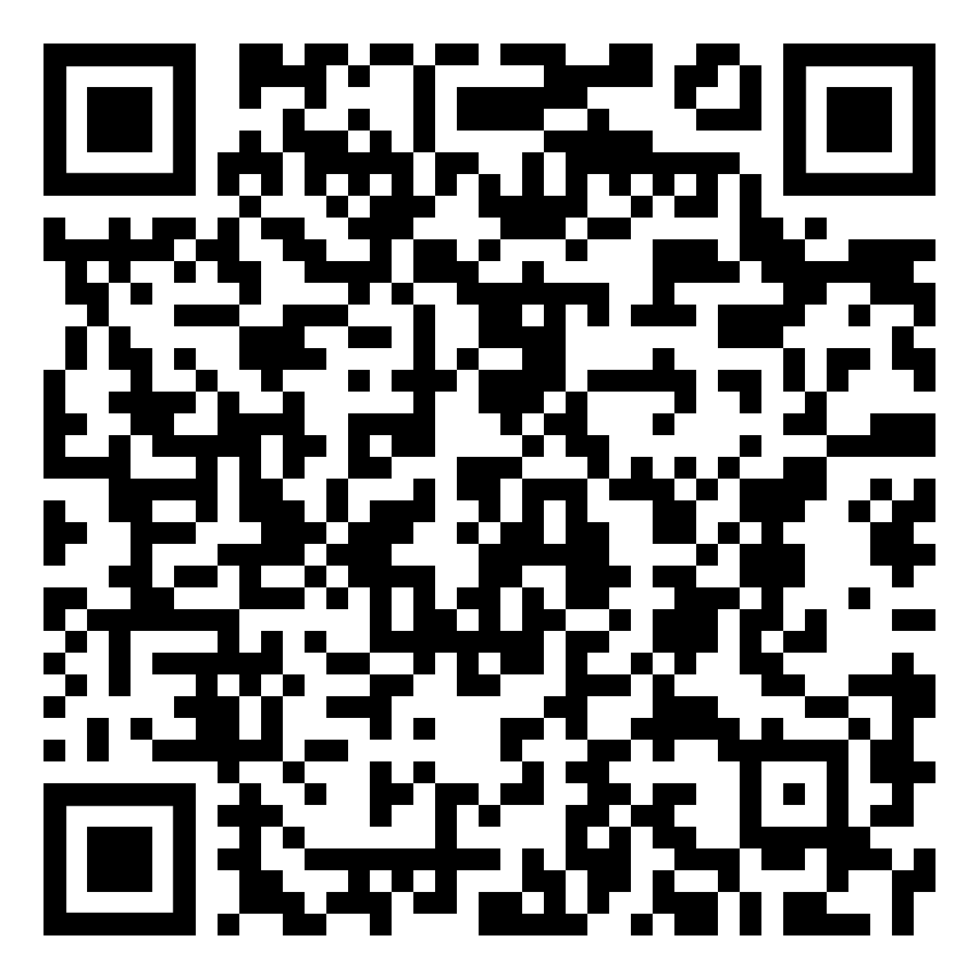
Federal Employees Group Life Insurance
FEGLI is term life insurance. It does not build any cash value.
There are no regularly scheduled open seasons to elect or increase FEGLI coverage. OPM schedules open seasons intermittently and rarely. Annuitants are not eligible to participate in open season (though certain compensationers are).
FEGLI Handbook:
Notes:
This Handbook is a great resource for all things FEGLI: https://www.opm.gov/healthcare-insurance/life-insurance/reference-materials/federalbooklet.pdf

Slide 67
Federal Employees Group Life Insurance
In order to carry any FEGLI coverage into retirement, you must have been covered for the five years prior to retirement
Annuitants can reduce or cancel FEGLI coverage at any time
If annuitant elects to reduce or cancel any part of FEGLI coverage, the election is irrevocable
Annuitants cannot increase coverage, even during open season

Slide 68
Federal Employees Group Life Insurance
Basic - Final salary rounded up to nearest 1,000 plus $2,000
Option A - $10,000
Option B - Final salary rounded up to nearest $1,000. Increased by up to 5 multiples
Option C - Family: $5,000 spouse and $2,500 eligible children. Increased by up to 5 multiples

Slide 69
Federal Employees Group Life Insurance
Basic – Final salary rounded up to nearest $1,000 plus $2000
Three choices at retirement:
  75% Reduction – payout reduces 2% per month starting at age 65* until it reaches 25%, then frozen. No premiums once it starts to reduce.
  50% Reduction – payout reduces 1% per month starting at age 65* until it reaches 50%, then frozen. Premiums increase with age for life.
  No Reduction – payout remains the same. Premiums increase with age for life unless annuitant switches to 75% reduction.
  *or at retirement if later
Notes:
The 75% reduction is the common election as it becomes free when the benefit reduction kicks-in. The other options can be cost prohibitive. If in doubt they can select the higher option as FEGLI can be reduced or cancelled at anytime.

Slide 70
Federal Employees Group Life Insurance
Option A - $10,000 benefit
  The amount of Option A coverage automatically begins reducing at age 65, or retirement if later.
  The amount of coverage reduces by 2% ($200) each month until the amount has been reduced by 75%. Only 25% of the original amount ($2,500) is payable as a death benefit once the full reduction has been reached. No premiums once it starts to reduce.

Slide 71
Federal Employees Group Life Insurance
Option B
  Final salary rounded to next $1,000. Up to 5 multiples.
  At retirement
    Elect number of multiples you want to continue
    choose “no reduction” or “full reduction” at age 65*
    You may split elections among your multiples
    *or at retirement if later

Slide 72
Federal Employees Group Life Insurance
Option B
  Full Reduction – the original value reduces by 2% each month for 50 months, at which time no benefits are payable. No premiums once it starts to reduce.
  No Reduction – no reduction in coverage, but you will continue to pay premiums associated with your age group.

Slide 73
Federal Employees Group Life Insurance
Option C – Family
  $5,000 spouse and $2,500 for eligible children
    up to 5 multiples
  At retirement:
    Elect number of multiples you want to continue
    Choose “no reduction” or “full reduction” at age 65*
    You may split elections among your multiples
    *or at retirement if later
Notes:
https://www.opm.gov/healthcare-insurance/life-insurance/reference-materials/federalbooklet.pdf
Eligible family members for Option C include a spouse (including a spouse from a valid common law marriage) and eligible dependent children. To be eligible, dependent children must be unmarried and under age 22, or if age 22 or over, incapable of self-support because of a mental or physical disability that existed before the child reached age 22. Eligible dependent children include your natural children, adopted children, stepchildren who live with you in a regular parent-child relationship, recognized natural children, and foster children (if they live with you in a regular parent-child relationship). Grandchildren are not covered unless they qualify as foster children. Stillborn children are not covered.
If you have any questions about eligible family members, please consult your human resources office; that office is responsible for determining eligibility

Slide 74
Federal Employees Group Life Insurance
Option C – Family
  Full Reduction – the value reduces by 2% of the original amount each month for 50 months, at which time no benefits are payable. No premiums once it starts to reduce.
  No Reduction – no reduction in coverage, but you will continue to pay premiums appropriate to your age group.

Slide 75
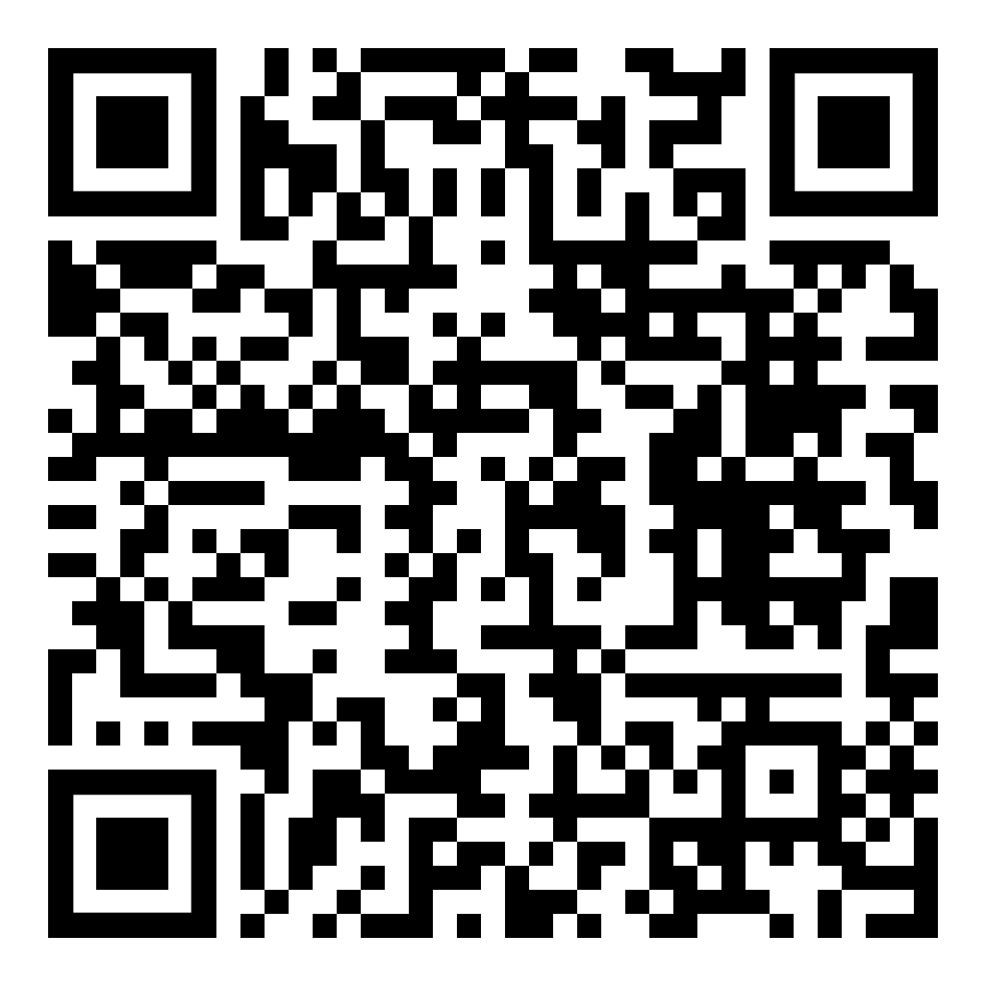
Federal Employees Group Life Insurance
Premiums for Annuitants
  https://www.opm.gov/healthcare-insurance/life-insurance/program-information/#url=Premiums-for-Annuitants
FEGLI Calculator (continue through to calculate coverage following retirement)
  https://www.opm.gov/retirement-center/calculators/fegli-calculator/

Slide 76

The Thrift Savings Plan (TSP) is administered by the Federal Retirement Thrift Investment Board (FRTIB). The Board is required by law to manage the TSP solely in the interest of TSP participants and their beneficiaries.
An Employee Thrift Advisory Council (ETAC) provides advice to the Board on investment policies and administration of the TSP.
Notes:
The point of this information is that the TSP is ran for the benefit of the employees. It is not a corporation trying to extract profit for its investors.

Slide 77
Employer Contributions
  Agency Automatically contributes 1%
  Matches first 3% dollar for dollar
  Matches next 2% 50 cents on the dollar
Maximum: If employee contributes 5% (or more), the Postal Service will contribute 5%.
Those that don’t contribute at least 5% are missing out on employer contributions.
Notes:
https://www.tsp.gov/making-contributions/contribution-types/

Slide 78
TSP ‘My Account’
  Create a username, password, and ThriftLine PIN to access your account. Prompts to verify your identity, update your contact information, and set up your account security.
  Should take 5 to 10 minutes for most. You need to receive a one-time passcode to your phone by text message or voice call to verify your identity during the setup process.
  www.tsp.gov

Slide 79

When you retire with a significant TSP balance, a host of financial and retirement planners, insurance salesmen, stockbrokers, bankers, hedge-fund operators, and the like are going to be very interested in that balance. They will try and convince you to take your money out of the TSP and invest it with them.
Notes:
We want to make the audience aware of snake oil salesman. Retirement accounts are a huge target.
See also the March 2020 Retirement column “Snake oil”
https://www.nalc.org/news/the-postal-record/2020/march-2020/document/DRM.pdf

Slide 80
What is the average net expense I will pay for every $1,000 I invest?
What additional annual fees, commissions, or charges will I pay for investments?
What profit do you make if I invest with you?
Do you have a responsibility (fiduciary obligation) to put my interests ahead of your own?
Notes:
These questions can help the retiree make decisions whether this is the type of financial planner/etc. that they want to do business with and help make a fully informed decision.

Slide 81
Will your plan protect my retirement from creditors’ claims?
When I retire, can I receive a series of scheduled withdrawals without giving up control of my account?
Can I change my investments or take withdrawals without being subject to surrender fees or back-end charges?
Notes:
These questions can help the retiree make decisions whether this is the type of financial planner/etc. that they want to do business with and help make a fully informed decision.

Slide 82
It costs money to operate any financial investment fund. A standard way to measure such costs is to look at expense ratios.
The total expense ratios for TSP funds range from 0.048% to 0.079%.
  $0.48 to $0.79 per $1,000.
Compare that with the expense ratio of for-profit actively managed mutual funds (0.5% to 0.75% is considered reasonable).
  $5 per $1,000.
10 x
Notes:
01/15/25 https://www.tsp.gov/tsp-basics/expenses-and-fees/
Based on 2040 lifecycle fund, the total expense ratio is 0.053%
G 0.049%
F 0.049%
C 0.048%
S 0.079%
I 0.054%
L 0.050% to 0.054%
1/21/25 https://www.investopedia.com/ask/answers/032715/when-expense-ratio-considered-high-and-when-it-considered-low.asp#:~:text=Key%20Takeaways&text=A%20reasonable%20expense%20ratio%20for,typically%20considered%20high%20these%20days.
A reasonable expense ratio for an actively managed portfolio is about 0.5% to 0.75%, while an expense ratio greater than 1.5% is typically considered high these days.

Slide 83
Age 59 ½ early withdrawal penalty
If you receive a TSP withdrawal before age 59 ½ and are still working, in addition to the regular income tax, you may have to pay an early withdrawal penalty tax equal to 10% of any taxable portion of the payment that is not transferred or rolled over.
If you separate from service during or after the year you reach age 55, then the 10% early withdrawal penalty tax does not apply.

Slide 84
After separation you can:
  leave your money in the TSP
  transfer eligible money into your TSP (e.g., IRA)
  continue to accrue earnings on your account
  change your investment choices
Cannot make contributions
Notes:
Tax Rules about TSP payments https://www.tsp.gov/publications/tspbk26.pdf

Slide 85
After separation, there are three basic withdrawal options:
  Installment payments
    Monthly, quarterly, or annual
    Fixed dollar amount or based on life expectancy
  Partial or total distributions
  Annuity purchases
You can choose any of these options or any combination
Withdrawals are subject to federal income tax

Slide 86
Required Minimum Distribution (RMD)
  IRS requires RMDs beginning in the calendar year when you become age 73 (if you reach 73 in 2023 or later) and are separated from service.
  If you do not start withdrawing by age 73 or the total amount of your withdrawals does not satisfy the RMD, TSP will disburse your RMD or issue a supplemental payment for the remaining amount of your RMD by the deadline each year.
  If they automatically send you an RMD and you have both traditional and Roth balances, the RMD will be proportional from each balance.
Notes:
President signs SECURE 2.0 Act — On December 29, 2022, President Biden signed the Setting Every Community Up for Retirement Enhancement (SECURE) 2.0 Act of 2022 into law. SECURE 2.0 increases the start age for required minimum distributions from 72 to 73 in 2023 and then further increases the start age to 75 in 2033.

Slide 87
Required Minimum Distribution (RMD)
  RMDs will increase under the SECURE 2.0 Act of 2022
  RMD at age 75 by 2033
RMD
Notes:
President signs SECURE 2.0 Act — On December 29, 2022, President Biden signed the Setting Every Community Up for Retirement Enhancement (SECURE) 2.0 Act of 2022 into law. SECURE 2.0 increases the start age for required minimum distributions from 72 to 73 in 2023 and then further increases the start age to 75 in 2033.

Slide 88
After you separate from service, you can take multiple post-separation partial withdrawals.
You’ll be able to choose whether your withdrawal should come from your Roth balance, your traditional balance, or a proportional mix of both.
You’ll be able stop, start, or make changes to your installment payments at any time.
You'll have enhanced online tools to help you make withdrawals in the My Account section of tsp.gov.

Slide 89
You can purchase a life annuity (a monthly benefit paid to you for life)
  Single life annuity – with level or increasing payments
  Joint life annuity with your spouse – with level or increasing payments, and with 100% or 50% survivor annuity
  Joint life annuity with someone other than your spouse – with level payments, and with 100% or 50% survivor annuity
    If joint annuitant other than your spouse is more than 10 years younger than you, you must choose a 50% survivor benefit, except in cases of former spouse court order

Slide 90

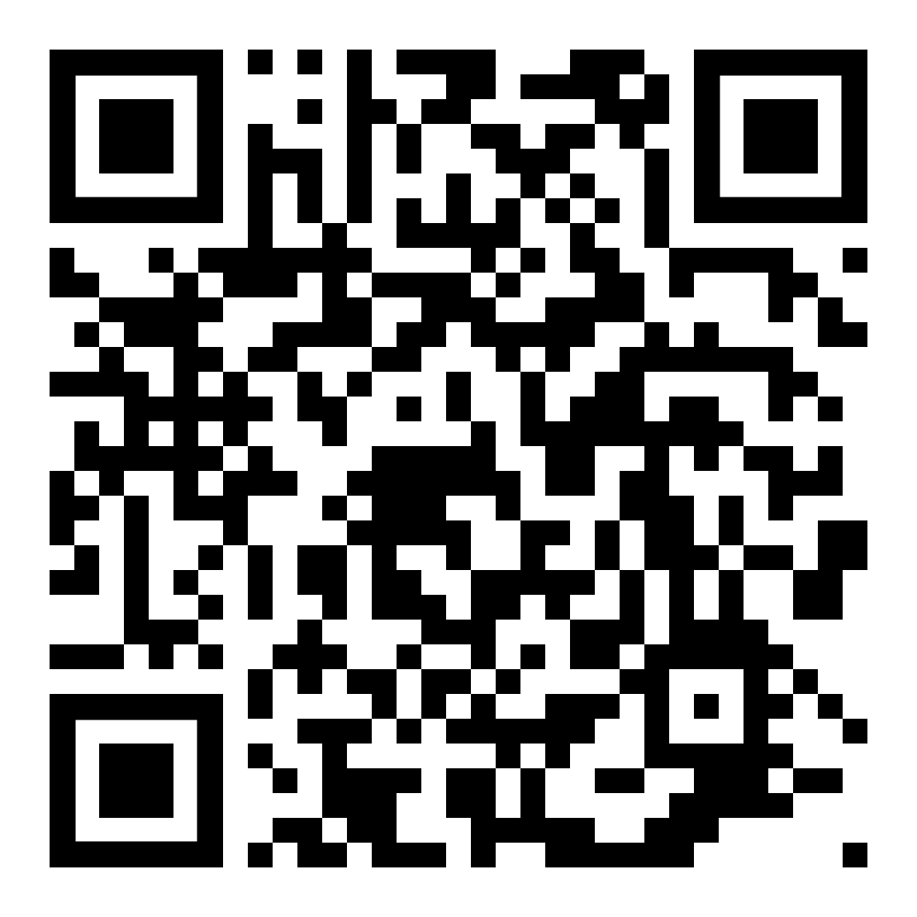
TSP Publications – Distributions
https://www.tsp.gov/forms/
Notes:
This handbook is a great resource, and each attendee should download a copy for their reference.

Slide 91
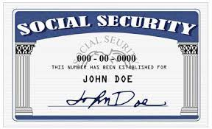
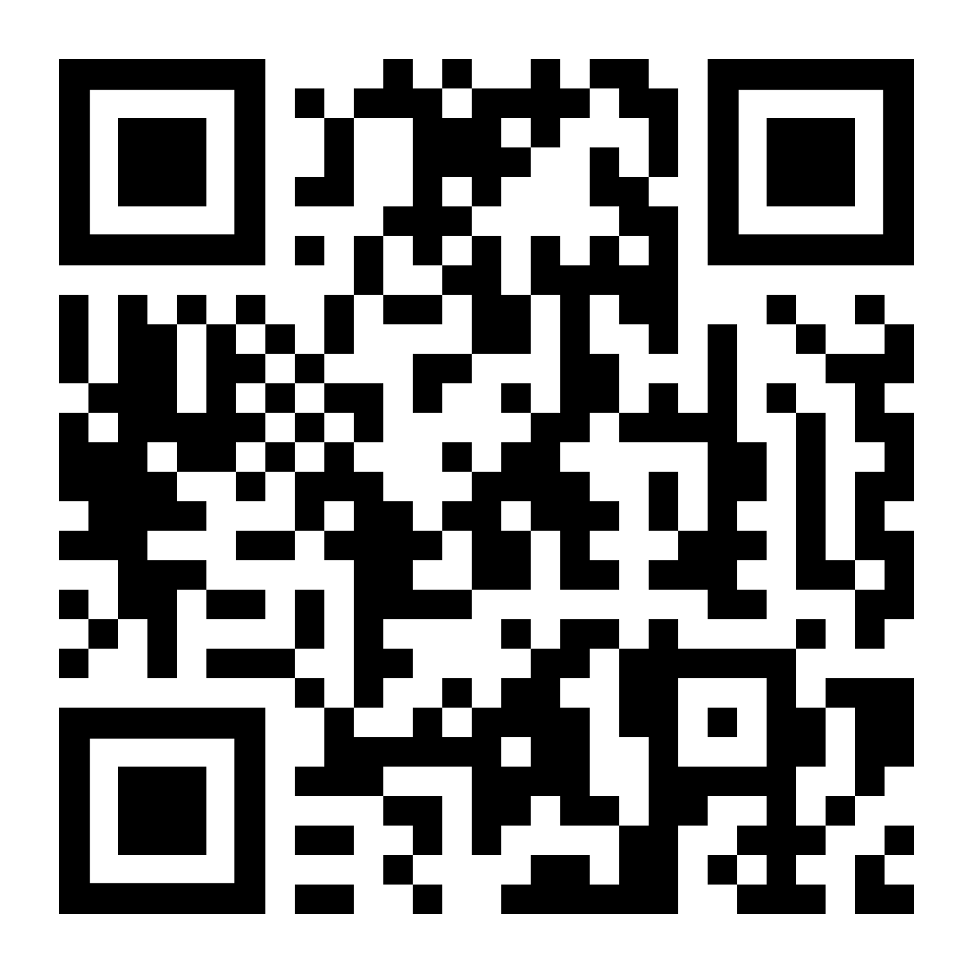
Social Security Administration
To create your own social security account online and get your estimate, go to:
  https://www.ssa.gov/myaccount/

Slide 92
Social Security Administration
Can start receiving partial benefits as early as age 62.
Full benefits at Full Retirement Age (FRA).
If you start receiving early, your benefits will be reduced by a small percentage for each month before your FRA, depending on your year of birth.
Example – if you were born 1960 or later and retire at 62 your benefit would be 30% lower than if you waited until your FRA of 67.
Notes:
Reminder: Full Retirement Age (FRA) under Social Security should not be confused with FERS Minimum Retirement Age (MRA)

Slide 93
Social Security Administration
FRA depends on your year of birth
Age | Year of birth
66 | 1943 – 1954
66 and 2 months | 1955
66 and 4 months | 1956
66 and 6 months | 1957
66 and 8 months | 1958
66 and 10 months | 1959
67 | 1960 and after

Slide 94
Social Security Administration
Working beyond your FRA
  Each extra year of work adds another year of earnings to your Social Security record.
  Your benefit will increase until you start receiving your benefits or until you reach age 70. The percentage varies depending on your year of birth.
  For example, if you were born in 1943 or later, you’ll add 8 percent to your benefit for each year you delay signing up for Social Security beyond your full retirement age.

Slide 95
Social Security Administration
Earnings limit – You can continue to work and still get retirement benefits. Social Security will reduce your benefits if your earnings exceed certain limits before you reach full retirement age:
  The years before your FRA – SSA will deduct $1 in benefits for each $2 you earn above the annual limit ($23,400 for 2025).
Notes:
https://www.ssa.gov/news/press/factsheets/colafacts2025.pdf

Slide 96
Social Security Administration
Earnings limit
  In the calendar year you reach your FRA – SSA will reduce your benefits $1 for every $3 you earn over an annual limit ($62,160 for 2025) until the month you reach FRA.
  Once you reach FRA there is no earnings limitation.

Slide 97
Best day to retire
Once you are eligible to retire, you have the absolute right to decide when to retire. There may be financial considerations:
  Entitlement to FERS annuity begins the first day of the month following the month in which you retire. Therefore, many letter carriers decide to retire the last day of a month.
  Annual leave and sick leave are not credited if an employee does not remain employed for an entire pay period, so some decide to retire last day of a pay period to receive the leave.
  Big picture: any day that ends in ‘Y’ is a good day to retire.
Notes:
CSRS can retire on the 1st, 2nd, or 3rd day of the month and begin entitlement. Otherwise entitlement starts at the beginning of the next month like FERS.
OPM computes years of service for determining amount of annuity in years and months. Days over a month are dropped. So some LCs decide to retire on a date that results in the total years of service computing to exact years and months, with no (or few) extra days.
Annual leave and sick leave are credited each pay period. But if an employee does not remain employed for an entire pay period, no AL or SL is credited. Neither AL nor SL is prorated for working part of a pay period. So some LCs decide to retire on the last day of a pay period.
The amount of the Special Annuity Supplement is computed based on years of service under FERS (not including military time, prior non-career federal service, saved sick leave, etc.) rounded to the nearest whole number. So some FERS retirees decide to retire on a date that results in years of FERS service being just over 6 months instead of just under six months.

Slide 98

Get your annuity estimate
Call USPS Shared Services at 877-477-3273 and ask for annuity estimate based on desired retirement date.
Online at USPS LiteBlue for a quicker estimate.
Estimates do not bind you to retire.

Slide 99
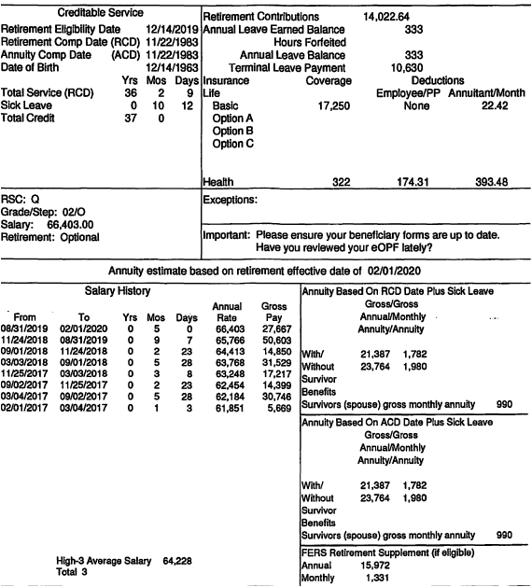
Annuity Estimate
Notes:
This is what a mailed annuity estimate looks like. Next slides discusses what it contains.

Slide 100
Annuity Estimate
Check what retirement date the estimate is based on
Retirement Comp Date (RCD) is used to determine eligibility to retire and assumes all service listed on the service history report is accurate
Total Time = Total Actual Service plus Sick Leave
  Used to determine annuity computation
Contains High-3 Average Salary
Includes estimates with and without a survivor annuity benefit
Includes special annuity supplement estimate
Notes:
The Retirement Computation Date (RCD) is used to determine eligibility for retirement. The RCD assumes all service listed on the attached Service History Report - career, non-career, military, USPS or other Federal Agency – is accurate. The Annuity Computation Date (ACD) reflects service for which FERS contributions are funded and therefore creditable for the computation of your annuity. The ACD does not include service for which FERS contributions were not made, or were made and refunded to you, but you did not complete a redeposit.

Slide 101
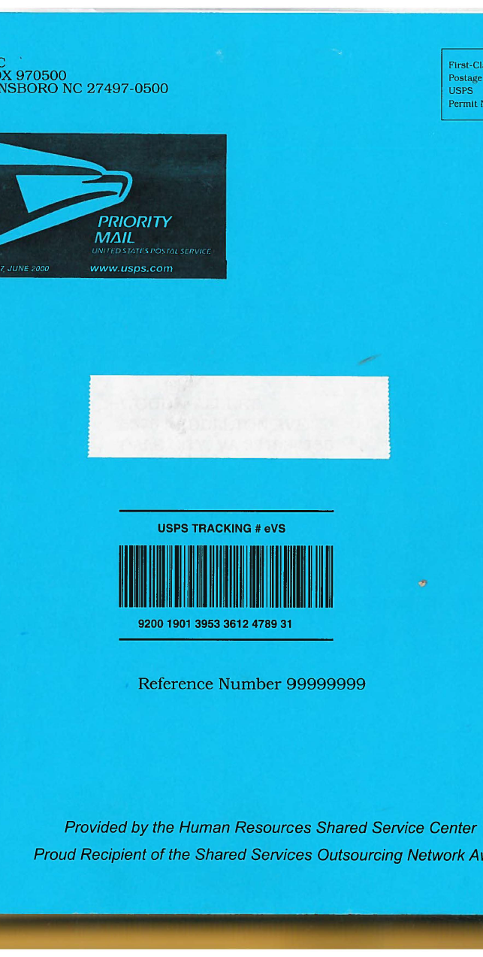
Request an Application
Call HRSSC (877) 477-3273 and ask for a retirement application.
  It includes the necessary forms, each pre-printed at the top with your name and Employee Identification Number.
When you receive the packet, call HRSSC back to schedule counseling. Their schedule fills up quickly!

Slide 102
Uniforms
Payment to the vendor is not allowed if the following conditions exist:
  The employee separates from the uniform program for any reason, including retirement, within 30 days following purchase of items of uniform wear that are not recognizable as distinctive uniform items unless worn with the basic outer garments of the uniform.
    Nondistinctive items: shoes, gloves, rubbers, galoshes, overboots, hose, face masks, pith helmets, and belts.
  When there is evidence that, before making the purchase, the employee indicated an intention to separate from the uniform program for any reason, including retirement…
See ELM Section 936.2

Slide 103
Official Personnel Folder
Official Personnel Folders (OPFs) contain important documents such as:
  Health and life insurance enrollments
  Designations of Beneficiary
  Form 50 history
Before you retire, save your eOPF. You will lose access immediately upon separation. You will not be able to retrieve documents from USPS after separation.
Problems can arise with retirement that can be resolved easily if the retiree has these documents.

Slide 104
Retirement Counseling
Call USPS HRSSC and request a counseling session.
Session is on the clock if scheduled during tour of employee.
You have a right to have your spouse and/or advisor present at the session.
  If the spouse/advisor is also a postal employee, they do not have a right to be on the clock.
You have a right to a private space for the session.
M-01708 in NALC’s Materials Reference System.
Notes:
http://mseries.nalc.org/M01708.pdf
Retirement Counseling ELM 589 https://about.usps.com/manuals/elm/html/elmc5_064.htm (CSRS provisions are found in Section 569)

Slide 105
Complete the Forms
The forms in the application book are preprinted with your name and employee ID number, which will help ensure efficient and problem-free processing.
Copy the forms so that a blank form is always available. Some of the forms are not valid if erasures, whiteouts or corrections are made.
Utilize the retirement counseling if you have questions about the forms.
Make copies of the completed forms for your records.

Slide 106
Certified Summary of Federal Service
Certified Summary of Federal Service
  SF 3107-1 (FERS)
  SF 2801-1 (CSRS)
This form, provided in the retirement application, will come blank. However, the form clearly asks you to review the information after the employing office completes and certifies the form. You are not required to sign this form (blank or completed).
If you request the Postal Service complete the form so that you can review it, and they refuse, talk to your shop steward. They can initiate a grievance prior to your separation. It doesn’t have to stop you from retiring. In this event, shop stewards should consult with the Retirement Department.
Notes:
Postal Record Contract Talk, Retirement Processing Issues (June 2018): https://www.nalc.org/news/the-postal-record/2018/june-2018/document/ct.pdf

Slide 107

Submit the Application
Send the completed forms to HRSSC / USPS. Ideally 60 days prior to separation.
After your last day, USPS will finalize their portion and send to OPM.
OPM will send you a CSA number and begin interim payments, usually without delay.
OPM makes annuity payments the first business day of the month. The payment is for the preceding month.

Slide 108
Interim Payments
While OPM processes your application and calculates your benefit, they will begin making interim payments
  Computed at about 80% of estimated net annuity
  Only federal income taxes are withheld
OPM will finalize your application
  Typically takes 2-3 months
  Begin paying your exact benefit with appropriate deductions
  Will account for any back pay due to the interim payments
Notes:
Advise that retirees should have some money set aside when retiring incase their interim payments are insufficient to cover their expenses (or don’t start in a timely manner).

Slide 109
Terminal Leave Payments
Lump sum terminal leave payment includes:
  accumulated AL up to maximum carryover (normally 440 hours, but expanded to 520 hours into the 2025 leave year)
  unused donated leave
  holidays that fall within the terminal leave period (for FTRs and PTRs)
Leave in excess of the carryover will be forfeited
  Any part of the unused AL earned during the leave year of separation that is in excess of the carryover is granted prior to separation. AL would need to be requested. See ELM 512.732b
Notes:
M-02002 changes carry over limit 520 into leave year 2025
https://s3.amazonaws.com/mseries.nalc.org/02002.pdf

Slide 110
Direct Deposit
OPM requires direct deposit of monthly annuity
Deposit can be to an account at a financial institution such as a credit union or bank
Or deposit can be to a Direct Express Card
  Can be used to make purchases at stores or financial institutions that accept MasterCard. There are no fees for the deposit into the card each month, and no charge for using the card to make purchases.
  Go to www.GoDirect.gov for information about fees and the surcharge-free network.

Slide 111

Post-Retirement Debt Collection
If you receive notice from USPS after separation that you owe money, immediately contact your branch and your NBA office. Two ways to appeal:
  30-day time limit to appeal through the Debt Collection Act which requires USPS to provide appeal rights.
  Or file a grievance which must be received at Step B within 30 days from the date the retiree first learned, or may reasonably have been expected to have learned, of the Postal Service’s intent to collect the debt.
Notes:
This right was introduced with the 2016 – 2019 National Agreement.
It is found on page 217 of the 2019-2023 National Agreement.

Slide 112

Post-Retirement Debt Collection
If you do not timely appeal (or pay/make a payment plan), USPS will advise the U.S. Treasury, which will deduct the debt from your retirement, income tax, social security, etc., without any appeal rights. Treasury will add interest and penalties.

Slide 113

OPM Services Online
Sign up!
www.servicesonline.opm.gov/
You need your CSA number and a temporary password, so you can’t sign up until you receive those from OPM.

Slide 114
OPM Services Online
View/print 1099-R tax forms
Change federal and state income tax withholding
View/print annuity statement and verification of income
View/print a year-to-date summary of payments
View/print verification of life insurance (FEGLI)
Change mailing address
Change password
Notes:
Functions that can be performed on Services Online

Slide 115
OPM Services Online
View the status of case while in interim pay
Establish an allotment to an organization
Request duplicate annuity booklet
Set up a checking or savings allotment
Sign up for direct deposit of annuity payment
Update email address/opt-in to receive information electronically
View/print retirement services reference card (ID card)
Notes:
Functions that can be performed on Services Online

Slide 116

Federal Income Tax
Your annuity is subject to federal income tax. The total amount you contributed into the Civil Service Retirement and Disability Fund over your working career, however, is tax sheltered, since that amount has already been subject to federal income tax.
Form 1099-R used to detail distributions from pensions.
  Will be available by end of January each year. Mailed and on Services Online.
  Includes Gross and Taxable amount.

Slide 117
Notice of Annuity Adjustment
OPM mails a hardcopy once a year if there is a change
  e.g., COLA increase
Notice shows:
  Gross
  Deductions
  Net
Survivor annuity is not listed as a deduction
  The gross annuity is the amount after reduction for survivor annuity

Slide 118
Notice of Annuity Adjustment
Some deduction/addition codes used on the NOAA
Code | Deduction
04 | Union Dues
31 | Federal Tax
42 | Dental Insurance
45 | Letter Carrier Political Fund
46 | FEGLI Basic Life Insurance
67 | FERS Special Annuity Supplement

Slide 119

Maintaining NALC Membership
Article 2 Section 1(a):
  Membership in the NALC shall be… retirees… who were regular members of the NALC when they retired…
Article 2 Section 1(e):
  A Form 1189 (Dues Check-off Provision) must be signed by all retiring members within the NALC who wish to retain their membership in said organization. An annuitant who was a member in good standing at the time of retirement may also sign this form and have their membership reinstated.
Form 1189 must contain CSA number.
Notes:
Sept/Oct 2024 Postal Record p.50 Nicole Rhine’s article on constitutional change regarding retiree membership and other reminders https://www.nalc.org/news/the-postal-record/2024/september-october-2024/document/s-t-1.pdf

Slide 120

Maintaining NALC Membership
National Constitution Article 7(b):
A member who has retired from the Postal Service under the CSRS or FERS shall pay to the National Association $7 per annum…

Slide 121
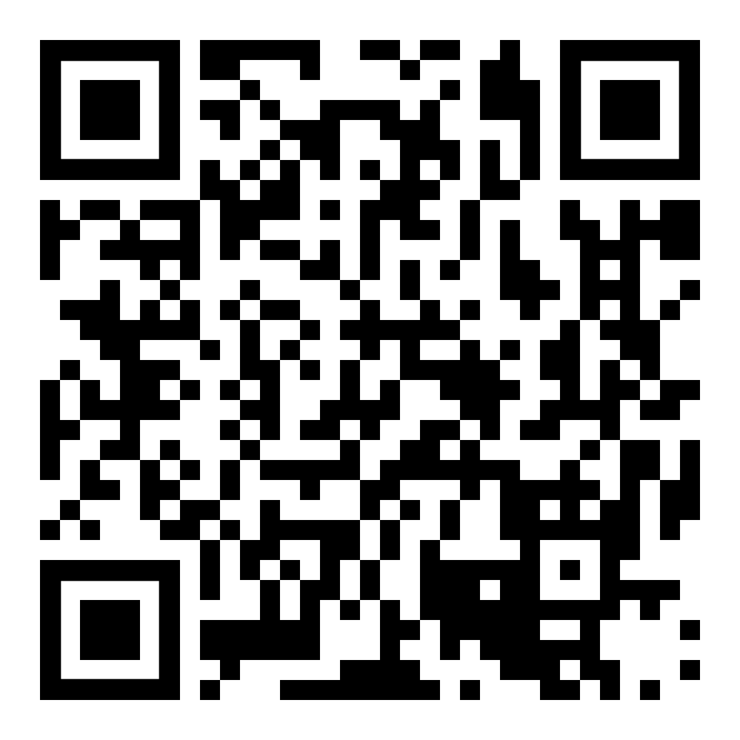
Important Phone Numbers
USPS Shared Services: (877) 477-3273 option 5
NALC Retirement Dept: (202) 393-4695
  Toll-free (800) 424-5186
    Mon., Wed., Thur. 10-12 & 2-4 EST
National Business Agent:
Region 15 Bruce Didriksen
Branch 38 Director of Retirees
Ron Villegas 973-564-7244 Ext. 21
Notes:
The QR code goes to nalc.org > regions so that participants can look up their NBA contact information.

Slide 122

Need More Information?
NALC.org Workplace Issues Retirement
  Questions & Answers booklets
  Retirement columns
  COLA projections and updates
  Phone numbers
OPM.gov Retirement
  Questions and answers
  CSRS and FERS Handbook for Personnel and Payroll Offices
    The definitive rules and procedures to become a guru
Notes:
NALC Retirement https://www.nalc.org/workplace-issues/retirement
CSRS and FERS Handbooks https://www.opm.gov/retirement-center/publications-forms/csrsfers-handbook/

Slide 123

Notes:
Problems or ideas for this presentation? Feel free to contact the retirement department (202.393.4695) with suggestions.
Thank you to everyone that has contributed!

