Slide 1
CSRS and FERS
A Guide for Employees
Approaching Retirement

Slide 2
Civil Service Retirement System (CSRS)
CSRS effective August 1920
A defined benefit plan (you get a guaranteed amount in retirement no matter what the stock market does)
Notes:
CSRS-The Civil Service Retirement Act, which became effective on August 1, 1920, established a retirement system for certain Federal employees. The Civil Service Retirement System (CSRS) is a defined benefit, contributory retirement system. Employees share in the expense of the annuities to which they become entitled. CSRS covered employees contribute 7, 7 1/2 or 8 percent of pay to CSRS and, while they generally pay no Social Security retirement, survivor and disability (OASDI) tax, they must pay the Medicare tax (currently 1.45 percent of pay). The employing agency matches the employee's CSRS contributions.
CSRS employees may increase their earned annuity by contributing up to 10 percent of the basic pay for their creditable service to a voluntary contribution account. See Chap 31 & SF2804.
Employees may also contribute a portion of pay to the Thrift Savings Plan (TSP). There is no Government contribution, but the employee contributions are tax-deferred. For more information about TSP, see the TSP website.

Slide 3
Federal Employees Retirement System (FERS)
FERS effective 1/1/1987 (applies retroactively to new hires on and after 1/1/1984)
3 components:
Basic Benefit Plan (+ Special Annuity Supplement)
A defined benefit plan
Social Security
Thrift Savings Plan (up to 5% matching)
A defined contribution plan (the amount you get in retirement depends on how much you contribute, your investment choices, and stock market performance)
Notes:
FERS-Congress created the Federal Employees Retirement System (FERS) in 1986, and it became effective on January 1, 1987. Since that time, new Federal civilian employees who have retirement coverage are covered by FERS.
FERS is a retirement plan that provides benefits from three different sources: a Basic Benefit Plan, Social Security, and the Thrift Savings Plan (TSP). Two of the three parts of FERS (Social Security and the TSP) can go with you to your next job if you leave the Federal Government before retirement. The Basic Benefit and Social Security parts of FERS require you to pay your share each pay period. Your agency withholds the cost of the Basic Benefit and Social Security from your pay as payroll deductions. Your agency pays its part too. Then, after you retire, you receive annuity payments each month for the rest of your life.
The TSP part of FERS is an account that your agency automatically sets up for you. Each pay period your agency deposits into your account amount equal to 1% of the basic pay you earn for the pay period. You can also make your own contributions to your TSP account and your agency will also make a matching contribution. These contributions are tax-deferred. The Thrift Savings Plan is administered by the Federal Retirement Thrift Investment Board.

Slide 4
This seminar focuses on
Regular (Immediate) Retirement
NALC members considering MRA+10, disability, or other types of retirement should obtain direct one-on-one advice from a branch officer, their NBA office, or the NALC HQ retirement department.

Slide 5
Some things to focus on
before retirement

Slide 6
Decide What Day To Retire
CSRS: Employees should retire on the last day of the month, or on the first 3 days of the month so that annuity will commence the following day after the effective date of retirement. If the employee is retired after the 3rd of the month, annuity will commence the first of the following month.
FERS: An employee can choose to retire on any day of the month, but whichever day they pick, the annuity will begin on the first day of the month following retirement. Therefore, if an employee retires on the last day of the month, their annuity commences the following day.

Slide 7
Age and Service Requirements for Regular Retirement
CSRS
FERS
Age
Service
Age
Service
55
30 years
MRA
30 years
60
20 years
60
20 years
62
5 years
62
5 years
MRA
10 years*
(*reduced benefits)
Notes:
CSRS:
In order to retire voluntarily you must meet both the age and service requirements outlined in this slide.
Once you meet these requirements you can retire at any time.
Generally, your benefits will begin on the first of the month after you retire unless you retire within the first three days of the month. If you retire within the first 3 days of the month your benefits will begin on the day after you retire.
FERS:
The minimum retirement age starts at age 55 and gradually increases until age 57 depending on your year of birth.
Under FERS you may also retire on a regular retirement once you reach your MRA provided you have at least 10 years of service. If you retire under the MRA + 10 provision, your retirement benefit will be subject to an age reduction that equals 5% for each year you are under age 62 at the time your benefits begin.
Under FERS your benefits will generally begin on the first of the month unless you retire under the MRA + 10 provision. If you retire under the MRA + 10 provision, you may choose to postpone receiving your benefits until a later date to reduce or eliminate the age reduction.
Age Reduction If you have 10 or more years of service and are retiring at the Minimum Retirement Age, your annuity will be reduced for each month that you are under age 62. The reduction is 5% per year (5/12 of a percent per month). However, your annuity will not be reduced if you completed at least 30 years of service, or if you completed at least 20 years of service and your annuity begins when you reach age 60. You can reduce or eliminate this age reduction by postponing the beginning date of your annuity.
Postponing the Beginning Date of Annuity to Reduce or Avoid the Age Reduction
You can reduce or eliminate the age reduction if you choose to have your annuity begin at a date later than the Minimum Retirement Age (MRA). You can choose any beginning date between your MRA and 2 days before your 62nd birthday. However, you cannot begin your annuity while you are reemployed.
If you postpone the beginning date of your annuity, you should be aware of the following—
Life Insurance You cannot continue your life insurance coverage unless you are receiving an annuity. Therefore, if you Postpone the beginning date of your annuity, your life insurance enrollment will terminate. When your annuity begins, the life insurance coverage you had when you separated from your employment will resume.
Health Insurance If you postpone the beginning date of your annuity, you will be eligible to temporarily continue your health benefits coverage for 18 months from the date of separation from your employing agency; however, you must contact your agency within 60 days and pay the total premium, plus a 2% administrative charge. When your annuity payments begin, you will again have the opportunity to enroll in a health benefits plan under the regular Federal Employees Health Benefits Program, and OPM will pay the Government share of the premium.
Federal Long Term Care Insurance If you already have Long Term Care Insurance Coverage when you separate for retirement, but postpone the commencing date of your annuity, your coverage will continue as long as you continue to pay premiums. If you are not enrolled in the Federal Long Term Care Insurance Program when you separate for retirement, you can apply for enrollment anytime after your separation, even if you postpone the commencing date of your annuity.
COLAs If you delay your annuity beginning date, your annuity rate will not include any cost-of-living adjustments (COLAs) that occur before you begin to receive the annuity. Once your annuity begins, you will be entitled to COLAs on any portion of your annuity which was computed under CSRS rules. However, you will not receive COLAs on the FERS part of your benefit until you are 62.
Survivor Benefits If you defer receipt of your annuity and die before you begin to receive it, your spouse can still receive FERS survivor benefits.
NOTE: Under certain conditions, active duty military service may count toward the 30 year, 20 year or 10 year requirements. We will discuss this a little later.

Slide 8
The Minimum Retirement Age* is determined as follows:
If you were born
Your MRA is
Before 1948 55 years
In 1948 55 years, 2 months
In 1949 55 years, 4 months
In 1950 55 years, 6 months
In 1951 55 years, 8 months
In 1952 55 years, 10 months
In 1953 to 1964 56 years
In 1965 56 years, 2 months
In 1966 56 years, 4 months
In 1967 56 years, 6 months
In 1968 56 years, 8 months
In 1969 56 years, 10 months
In 1970 and after 57 years
*Applies to FERS only
Notes:
The Minimum Retirement Age is determined as follows:
Before 1948, 55 years
1948- 55 years, 2 months
1949- 55 years, 4 months
1950-55 years, 6 months
1951- 55 years, 8 months
1952- 55 years, 10 months
1953 to 1964, 56 years
1965- 56 years, 2 months
1966- 56 years, 4 months
1967- 56 years, 6 months
1968- 56 years, 8 months
1969- 56 years, 10 months
1970 and after, 57 years

Slide 9
Amount of Creditable Service
for purposes of Eligibility
Years worked under CSRS or FERS
plus
Years of Military Service*
plus
Years of Non-Career Federal Service*
minus
LWOP in excess of 6 months in a calendar year***
*when eligible and required deposit made
**SL counts towards how much you get but not eligibility
***Unless the LWOP is due to on-the-job injury and OWCP pays wage-loss compensation, or LWOP is due to full-time union official employment and union pays employer contributions

Slide 10
Amount of Creditable Service: Unused Sick Leave counts towards how much you get but not eligibility
Sick leave is not creditable for establishing retirement eligibility
Sick leave balance at retirement is added to the length of service to calculate the amount of an immediate annuity
Notes:
As a result of the NDAA of FY 2010, FERS SL was allowed to be added to the annuity computation.

Slide 11
Amount of Creditable Service:
LWOP may reduce service credit
Cumulative LWOP in excess of 6 months in a calendar year is not credited for eligibility or computation purposes.
In other words, the first six months of cumulative leave without pay per calendar year IS credited.
Exceptions: All Leave Without Pay is credited if the LWOP was due to an on-the-job injury and wage loss compensation was paid by OWCP, or LWOP is due to full-time union official employment and union pays employer contributions, or LWOP is due to military furlough

Slide 12
Amount of Creditable Service:
Proration for part time service
•In determining eligibility to retire, part time service is creditable to the same extent as full-time service for both CSRS and FERS
CSRS - part time service prior to 4/7/86 is treated as full time for annuity calculation
•CSRS - part time service on and after 4/7/86 is prorated for annuity calculation
•FERS – all part time service is prorated for annuity calculation
Notes:
ELM 582.3 Part-Time Service
Retirement benefits that include part-time employment will be prorated by a ratio of the part-time hours worked to the number of hours a full-time employee would have worked.
Compute the actual time worked, and the number of full-time hours that could have been worked, for all periods of part time service (performed on or after April 7, 1986 for CSRS).
Include time worked in excess of the scheduled part-time tour of duty, not to exceed full-time credit, in the computation of the actual time worked.
Include periods of creditable time in a nonpay (LWOP) status in the computation of actual time worked. The "actual time worked" during nonpay status is based on the tour of duty in effect immediately before entry into the nonpay status.
Divide the total actual hours worked by the total full-time hours to obtain the CSRS proration factor (round to the nearest percent).
You can request an annuity estimate from USPS Shared Services that includes calculation of part time service.
See section 5 of the Blue Book – General retirement information Question 4 in the CSRS book, question 11 in the FERS book:
The high-3 calculation for part-time employees may differ; such employees may request a NARECS annuity estimate through the HR Shared Service Center and the high-3 amount will be shown on it

Slide 13
Crediting Military Service
Must be Active-Duty Service with Discharge Under Honorable Conditions
If Receiving Military Retired Pay, Must Waive it - Unless it is Based on 1) Disability Incurred in Combat or 2) National Guard Service
National Guard Service is
Generally Not Creditable

Slide 14
Crediting Military Service
Military Service prior to January 1, 1957 is creditable for retirement eligibility and computation, without making deposit
Military Service after 1956 may be creditable based on various factors, including whether deposit has been made prior to separation

Slide 15
How to Make Deposit for Military Service
Call USPS Shared Services: 877-477- 3273 (Option 5)
Complete SF 2803A (if CSRS) or
Complete SF 3108A (if FERS)
Submit completed SF with DD 214
Full deposit must be made to USPS prior to separation.

Slide 16
Crediting Unused Sick Leave CSRS and FERS
Sick leave balance at retirement is added to the length of service to calculate the amount of an immediate annuity
Sick leave is not creditable for establishing retirement eligibility
Notes:
As a result of the NDAA of FY 2010, FERS SL was allowed to be added to the annuity computation.

Slide 17
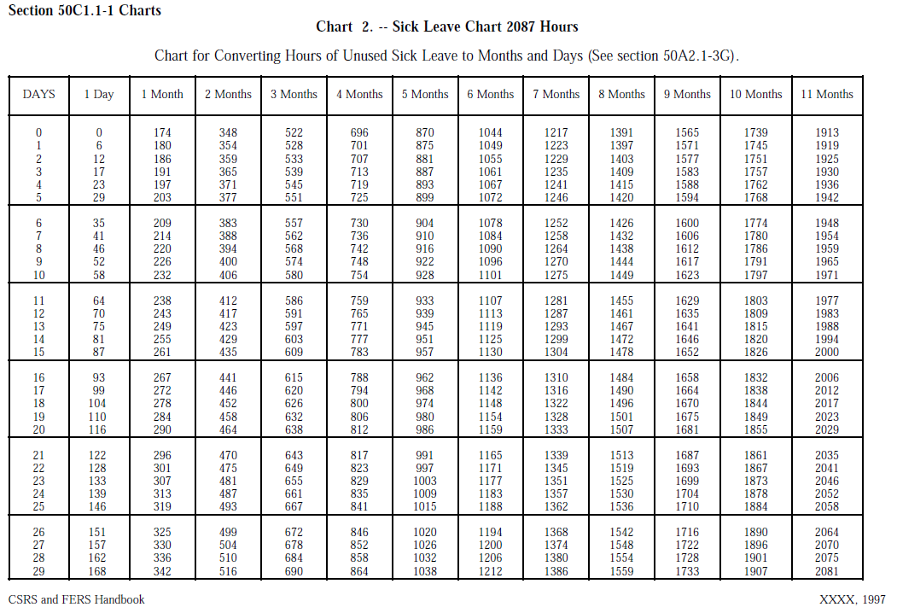
Notes:
http://apps.opm.gov/Listserv_Apps/list-sub.cfm

Slide 18
OPM calculates years and months only
CSRS FERS Handbook 50A2.1-2B
Calculating Length of Service
Length of service for annuity computation purposes is based on whole months (30 days). To determine the total length of service for annuity computation purposes, add all creditable civilian and military service and the period represented by the unused sick leave; then eliminate any fractional part of a month.
Notes:
http://apps.opm.gov/Listserv_Apps/list-sub.cfm

Slide 19
OPM calculates years and months only
OPM calculates amount of annuity using years and months; days short of a month (30) are dropped.
Notes:
HANDOUTS #1 & 2
CSRS FERS Handbook 50A2.1-2B https://www.opm.gov/retirement-services/publications-forms/csrsfers-handbook/c050.pdf See p.5
Calculating Length of Service
Length of service for annuity computation purposes is based on whole months (30 days). To determine the total length of service for annuity computation purposes, add all creditable civilian and military service and the period represented by the unused sick leave; then eliminate any fractional part of a month.

Slide 20
High-3 Average Salary
$
$
$
3 Consecutive Years of Basic Pay
Notes:
The high 3 average salary is the highest pay obtained by averaging the rates of basic pay in effect during any 3 consecutive years of service, with each rate weighted by the time it was in effect.
The 3 years need not be continuous, but they must consist of consecutive period of service. Two or more separate periods of employee that follow each other my be combined to make up the 3 years of service.
The 3 year period may start and end on whichever dates give the highest 3 years of basic pay. Since employee pay usually increases the longer you work, the high-3 usually occurs during the last 3 years of service. However, any 3 years will be used if it produces a higher average salary.
A break of 3 calendar days or less will be used to compute the high-3.
LWOP status for 6 months or less may be used in the high-3, however, LWOP over 6 months will not be used to compute the high-3.
Military pay will not be used in computing the high-3 unless the military service interrupts the civilian service and the employee exercises reemployment or restoration rights, civilian pay is projected over the period of military service and used to compute the high-3.

Slide 21
Sample High-3 calculation from USPS annuity estimate: Total-3 Average Salary Total: 64,228
Salary History From To Yrs Mns Days Annual Rate Gross Pay
08/31/2019 02/01/2020 0 5 0 66,403 27,667
11/24/2018 08/31/2019 0 9 7 65,766 50,603
09/01/2018 11/24/2018 0 2 23 64,413 14,850
03/03/2018 09/01/2018 0 5 28 63,768 31,529
11/25/2017 03/03/2018 0 3 8 63,248 17,217
09/02/2017 11/25/2017 0 2 23 62,454 14,399
03/04/2017 09/02/2017 0 5 28 62,184 30,746
02/01/2017 03/04/2017 0 1 3 61,851 5,669
Notes:
HANDOUT #3

Slide 22
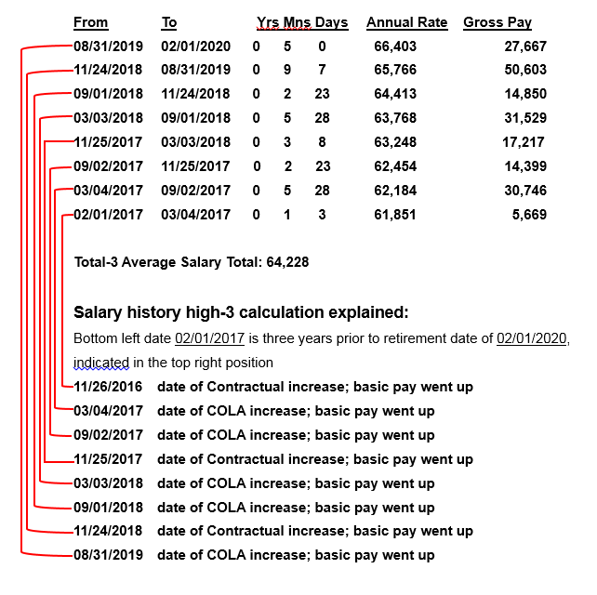
High-3 calculation from USPS annuity estimate:
Notes:
HANDOUT #3

Slide 23
General Formula
CSRS
FERS
1.5% x 5 years +
1.75%x 5 years +
2% x service over
10 years
1% or 1.1%* x years of service
*1.1% if age 62 (or older) with 20 (or more) years
Notes:
The general formula is used to compute basic annuities for voluntary, early voluntary, discontinued service, and deferred retirements. It is also used to compute disability retirements when the employee is over age 60 or the earned annuity is greater than the disability guaranteed minimum.
Under FERS, the general formula applies to the FERS component of an employee who transferred to FERS. While the CSRS general formula would apply to the CSRS component of an employee who transferred to FERS.

Slide 24
CSRS Calculation Example
Employee has 30 years of service (Full Time) and the high-3 average salary is $60,000
1.5% of $60,000 x 5 years = $ 4,500
1.75% of $60,000 x 5 years = $ 5,250
2.0% of $60,000 x 20 years = $ 24,000
Basic Annuity (per year) = $ 33,750
Notes:
CSRS Example:
Employee has 30 years of service and high-3 average salary of $98,000
1.5% of $98,000 (or $1470) x 5 years = $7,350
1.75% of $98,000 (or $1715) x 5 years = $8,575
2% of $48,000 (or $1960) x 20 years = $39,200
Basic Annuity (per year) = $55,125
(/12 = $4,593 per month)

Slide 25
FERS Calculation Example 1
Employee, age 60, has 30 years of service (Full Time) and High-3 average salary of $60,000
1.0% of $60,000 x 30 = $18,000
or
1% x 30 = 30%
30% x $60,000 = $18,000
Notes:
FERS Example:
Employee, age 62, has 24 years of service and high-3 average salary of $98,000
1.1% of $98,000 (or $1,078) x 24 = $25,872
(/12 = 2,156 per month)

Slide 26
FERS Calculation Example 2
Employee, age 62, has 30 years of service (Full Time) and high-3 average salary of $60,000
1.1% of $60,000 x 30 = $19,800
or
1.1% x 30 = 33%
33% x $60,000 = $19,800
Notes:
FERS Example:
Employee, age 62, has 24 years of service and high-3 average salary of $98,000
1.1% of $98,000 (or $1,078) x 24 = $25,872
(/12 = 2,156 per month)

Slide 27
FERS Special Annuity Supplement
Intended to substitute for the Social Security part of the total FERS benefit until age 62
Approximates the Social Security benefit earned under FERS
It is paid by OPM, not Social Security
Subject to earnings test
No COLAs
Ends at age 62
Notes:
The FERS Annuity Supplement is paid to certain FERS employees who retire before age 62. The supplement is an estimate of the amount of Social Security benefits earned during FERS civilian service.
If you retire before you reach age 62, you will be able to receive your FERS Basic Benefit, and if you choose, your Thrift Savings Plan benefit. You will not be able to receive your Social Security benefit until you reach age 62. However, you may qualify to receive the FERS Annuity Supplement until you reach age 62.
FERS Annuity Supplement---Chapter 51
Substitutes for the Social Security part of the total FERS benefit until you reach age 62.
Approximates the SS benefit earned while you worked under FERS.
Subject to the Social Security earnings test. If you work after retirement, your post-retirement earning could reduce or eliminate your FERS Supplement. The 2012 SS earnings limitation is $14,640. See BAL 12-101 Annual Changes.
No COLAs

Slide 28
FERS Special Annuity Supplement
To be eligible for the Supplement:
Employee must have 1 full calendar year of deductions under FERS, and
Must qualify for an immediate, non-disability retirement
MRA+10 retirement does not receive Special Annuity Supplement
Notes:
You can receive this supplement if you have worked under FERS for at least 1 calendar year, and you retire on an immediate, non-disability annuity (other than the “MRA + 10” retirement provision).
If you retire before you reach your MRA under an Early Optional or Discontinue Service Retirement, you have to wait until your MRA before you start receiving the Supplement.

Slide 29
Review USPS Annuity Estimate for Special Annuity Supplement
Beginning about Fall 2017, the Postal Service revised its retirement estimate computer program and began including estimates of Special Annuity Supplement amounts for those who are entitled to it.
See next slide for a sample.
Notes:
You can receive this supplement if you have worked under FERS for at least 1 calendar year, and you retire on an immediate, non-disability annuity (other than the “MRA + 10” retirement provision).
If you retire before you reach your MRA under an Early Optional or Discontinue Service Retirement, you have to wait until your MRA before you start receiving the Supplement.

Slide 30
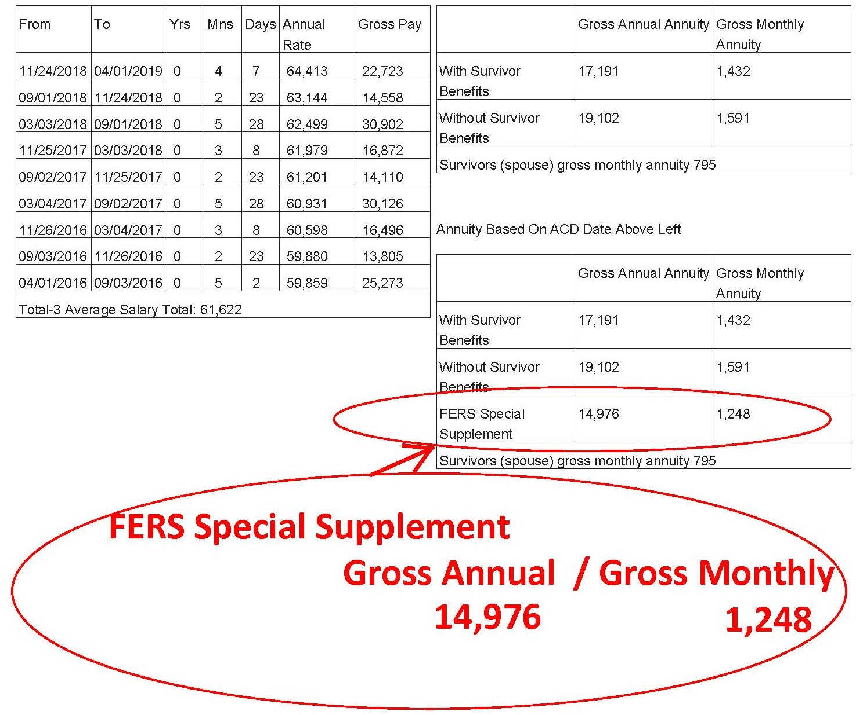
Notes:
HANDOUT #9
Beginning about Fall 2017, the Postal Service revised its retirement estimate computer program and began including estimates of Special Annuity Supplement amounts for those who are entitled to it. This slide is an example.
You can receive this supplement if you have worked under FERS for at least 1 calendar year, and you retire on an immediate, non-disability annuity (other than the “MRA + 10” retirement provision).
If you retire before you reach your MRA under an Early Optional or Discontinue Service Retirement, you have to wait until your MRA before you start receiving the Supplement.

Slide 31
Special Annuity Supplement (SAS)
Subject to earnings test.
Earnings are wages, including self-employment.
Earnings do not include investment gains, interest, pensions, TSP withdrawals, etc.
If you earn more than $19,560* in 2022, SAS will be reduced in 2023 by $1 for each $2 earned above that $19,560.
Must report earnings each year to OPM.
* Exempt amount may increase each year and is aligned with Social Security earnings limitation.

Slide 32
Maximum Annuity
CSRS
FERS
80% of the high-3 average salary
Equivalent to 41 years and 11 months service
Limit may be exceeded with sick leave credits
There is no maximum annuity under FERS

Slide 33
Reduction for Survivor Annuity
Applies if an employee:
Elects a survivor annuity for a spouse and/or former spouse
Has a former spouse entitled to a survivor annuity based on a valid court order, and/or
Elects to provide someone with an insurable interest annuity
NOTE: A SURVIVING SPOUSE CAN CONTINUE FEHB COVERAGE AFTER AN ANNUITANT’S DEATH ONLY IF A SURVIVOR ELECTION WAS MADE AND THE SPOUSE WAS ACTIVELY COVERED AT THE TIME OF DEATH.

Slide 34
Cost of Survivor Annuity Reduction
CSRS
FERS
2.5% x $3600
+
10% x Amount of base in excess of $3600
Survivor receives 55% of the base elected by retiree
Full survivor annuity (50%)
10% of annuity
Partial survivor annuity (25%)
5% of annuity
Notes:
CSRS-A spousal survivor annuity is 55% of an annuity computed as if the employee had retired on a disability retirement as of the date of death.
A spouse receives 55% of the HIGHER of 1 or 2 below: An annuity computed under the general formula (see Chap 50) based on the deceased employee's Hi-3 avg salary and length of service to DoD, including credit for unused sick leave.
A "guaranteed minimum" which is the LESSER of: 40% of the deceased employee's Hi-3 average salary; or
The regular annuity obtained after increasing the deceased employee's length of service by the period of time between the date of death and the date he or she would have been age 60.
FERS--A spousal survivor annuity is computed as if the employee retired optionally (with no age reduction) on the date of death.
Survivor receives 50% of the employee's basic annuity, based on the deceased employee's type of service, age, length of service, and high-3 average salary at date of death. (See Chapter 50.)
For employees with a CSRS annuity component, the spouse receives 50 percent of the combined CSRS and FERS benefit.

Slide 35
Flexible Spending Accounts
If you participate in the FSA, your period of participation ends the day after you retire. You may file a claim for the expenses of services or items that were received prior to the day after your retirement, but any services or items provided after your retirement date are not eligible for payment.
Claims for reimbursement of services or items received while still employed may be made until September 30 of the following year.
If you used your entire elected amount before it has been deducted from your pay, you will not be responsible for the remaining allotments.

Slide 36
Uniforms
ELM 936.2
Payment for Uniform Purchase After Separation of Employee
Payment to the vendor is not allowed if the following conditions exist:
a. The employee separates from the uniform program for any reason, including retirement, within 30 days following purchase of items of uniform wear that are not recognizable as distinctive uniform items unless worn with the basic outer garments of the uniform. In these cases notify both employee and specific vendor involved. Return the invoice to the vendor (see 936.32). Nondistinctive items include shoes, gloves, rubbers, galoshes, overboots, hose, face masks, pith helmets, and belts.
b. When there is evidence that, before making the purchase, the employee indicated an intention to separate from the uniform program for any reason, including retirement, involuntary separation, or bid to an assignment not requiring the same uniform category, do not process the invoice for payment. After placing a copy of the invoice in the employee’s uniform file with the appropriate remarks, return the invoice to the vendor advising why it will not be honored.

Slide 37
Official Personnel Folder (OPF)
OPFs contain important documents such as:
Health Benefits Program Registration
FEGLI Enrollment forms
Designations of Beneficiary
Form 50 history
Active employees have on-line access to their OPF through USPS LiteBlue.
Retirees do not have access to LiteBlue.
Most retirees will never have a significant need to access proof of past HBP registration, FEGLI designation of beneficiary, Form 50 pay history, etc. However, sometimes problems arise with retirement that can be resolved easily if the retiree has these documents.

Slide 38
Official Personnel Folder (OPF)
Before you retire:
Go on-line to Lite-Blue. Find your OPF. Copy it to paper or electronically. Save it.
USPS will delete your access to Lite-Blue the day after you retire and will send those OPF documents to the Federal Records Center. You will not be able to easily obtain these documents from USPS after you retire.
If you ever do need a document* to solve a problem or issue, you can simply retrieve it from your stored file.
*E.g., Health Benefits registration, FEGLI coverage, designation of beneficiary, debt collection related documents, etc.

Slide 39
Make blank copies of all retirement application forms
OPM will not accept a retirement application that includes erasures, scratch-outs, white-outs, or any other type of corrections actions, on certain specific forms, and on sections of other specific forms.
The best policy is to make no such corrections on any of the retirement forms.
Instead, before you start completing a form, copy it, so that in the event of an error, you can destroy the form with the error, again copy the blank form, and then begin again completing the form.

Slide 40
Some things to know about
after retirement

Slide 41
Cost of Living Adjustments (COLAS)
CSRS
FERS
Begins the first December after retirement
First COLA is prorated
Generally, not applied until the December after age 62
Exception: Disability
Notes:
COLAs are not automatic. There was no COLA payable for retirees in 2010 & 2011
Consumer Price Index (CPI) for urban wage earners and clerical workers from the third quarter average of the previous year to the third quarter average for the current year.
COLA for 2013?
OPM website has the list of all COLAs at: http://www.opm.gov/retire/annuity/cola/colalist.asp

Slide 42
Direct Deposit Required
OPM requires direct deposit of monthly annuity.
Deposit can be to an account at a financial institution such as a credit union or bank;
Or deposit can be to a Direct Express Card.
The card can be used to make purchases at stores that accept Debit MasterCard, pay bills, purchase money order at the Post Office, and get cash from an ATM or financial institution that accepts MasterCard. There are no fees for the deposit into the card each month, and no charge for using the card to make purchases.
Go to www.GoDirect.org for information about fees and the surcharge-free network.

Slide 43
Notice of Annuity Adjustment
Pensions are deposited monthly, on the first business day of each month. OPM only mails an explanation of benefits when there is an adjustment to an annuity (e.g., COLA increase, change in Health Benefit premiums or Life Insurance premiums, etc.)
When OPM sends a Notice of Annuity Adjustment, it will show 1) gross, 2) deductions, and 3) net. But the gross will be the amount after reduction for survivor annuity.
OPM does not list the cost of the reduction for survivor annuity as a deduction. Instead, OPM lists the gross annuity as the amount after reduction for survivor annuity.

Slide 44
Saved Annual Leave Upon Retirement
(Terminal Leave Payments)
Lump sum terminal leave payment includes:
accumulated AL up to maximum carryover (normally 440 hours, but 520 hours in 2022), plus
any unused donated leave, plus
holidays that fall within the terminal leave period (for Full-Time Regulars and Part-Time Regulars)
Any part of the unused annual leave earned during the leave year of separation that is in excess of the maximum carryover amount is granted prior to separation rather than paid out in the form of a lump sum payment.
ELM 512.732b
Unused donated leave is included in the terminal leave payment irrespective of the maximum carryover; and all earned leave is included, if retiring under an early out (VER).
Notes:
http://apps.opm.gov/Listserv_Apps/list-sub.cfm

Slide 45
ANNUAL LEAVE CARRYOVER INTO 2022 RETIREMENT
M-01940
MEMORANDUM OF UNDERSTANDING BETWEEN THE UNITED STATES POSTAL SERVICE AND THE NATIONAL ASSOCIATION OF LETTER CARRIERS, AFL-CIO
Re: Annual Leave Carryover for Leave Year 2022
The parties agree that for leave year 2022, regular work force career employees covered by the USPS-NALC Agreement may carry over 520 hours of accumulated annual leave from leave year 2021 to leave year 2022. In all other respects, the ELM provisions for payment of accumulated leave are not changed because of this Memorandum. This MOU will expire December 31, 2022.
“Although this memorandum did not impact the ELM provisions for payment of accumulated leave, after further discussion, the Postal Service has confirmed that employees that retire during leave year 2022 can receive a terminal leave payment of up to 520 hours.”

Slide 46
Post-Retirement Debt Collection
If you receive notice from USPS after retirement that you owe money to USPS, immediately contact your branch and your NBA office. The Debt Collection Act requires USPS to provide appeal rights. There is a 30-day time limit to appeal. A timely appeal will stop all collection efforts.
You can also file a grievance challenging a post-retirement debt collection notice, even though you are retired. The grievance must be received at Step B within thirty days from the date the retiree first learned, or may reasonably have been expected to have learned, of the Postal Service’s intent to collect the debt.
If you do not timely appeal, USPS will advise the U.S. Treasury, which can then deduct the claimed debt from your retirement, income tax, social security, etc., without any appeal rights. Treasury can also add interest and penalties.
Notes:
This right was introduced with the 2016 – 2019 National Agreement.

Slide 47
Post-Retirement Debt Collection
If you receive a debt collection letter from USPS after you retire, seek assistance from your branch, your NBA, or HQ.
Do not fail to initiate a timely appeal
Notes:
http://apps.opm.gov/Listserv_Apps/list-sub.cfm

Slide 48
Maintain NALC Membership
National Constitution
Article 2 Section 1(a):
Membership in the NALC shall be… retirees… who were regular members of the NALC when they retired…
Article 2 Section 1(e):
A Form 1189 (Dues Check-off Provision) must be signed by all retiring members within the NALC who wish to retain their membership… effective October 1, 1982.
Notes:
http://apps.opm.gov/Listserv_Apps/list-sub.cfm

Slide 49
1189 must include CSA number!
Notes:
http://apps.opm.gov/Listserv_Apps/list-sub.cfm

Slide 50
Federal Income Tax
Your CSRS or FERS annuity is subject to federal income tax, except that the total amount you contributed into the Civil Service Retirement and Disability Trust Fund over your working career is spread out over your projected retirement years and is sheltered, since that amount has already been subject to federal income tax.

Slide 51
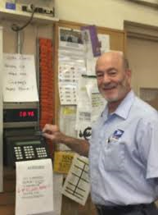
How
to
Retire

Slide 52
Get annuity estimate
Call USPS Shared Services, give date you want to retire, ask for annuity estimate.
Alternately, go on-line to USPS LiteBlue and enter data for a quicker estimate.
Requests for estimates in no way bind you to retire on any requested date.

Slide 53
Get the Retirement Application
OPM requires that retirement applications of current employees be submitted through the employing agency.
Call USPS Shared Services and ask for a retirement application packet (which USPS sends bound in a white cover). It includes all the necessary forms, each pre-printed at the top with your name and Employee Identification Number.
Copy the forms in the Retirement Application, so that a blank form is always available. Some of the forms are not valid if erasures, whiteouts or corrections are made.

Slide 55
Set up counseling
Call USPS Shared Services and request a phone counseling session.
You have a right to the counseling session on the clock.
You have a right to have your spouse and/or representative present at the session. (Although if they are also postal employees, they do not have a right to be on the clock.)
You have a right to a private space for the session.
See M-1708

Slide 56
Mr. Fredric V. Rolando
President M-01708
National Association of letter
Carriers, AFl-CIO
100 Indiana Avenue, NW Re: Q01N-4Q-C 07150373
Washington, DC 20001-2144 Class - Article 19
Dear Mr. Rolando:
Our representatives have met on several occasions to discuss the above-referenced case scheduled for
national arbitration.
After reviewing this matter, the parties agree to resolve this matter based on the following:
If an employee who is eligible for and has requested individual retirement counseling wishes to have
this counseling on the clock, local management will arrange reasonably private space for this
purpose and will permit the employee's spouse and or advisor to be with the employee during this
process. If the employee's spouse or advisor is a Postal Service employee only the employee
receiving the requested retirement counseling will be on the clock.
If such an employee is not able to call the Human Resources Shared Services Center to-begin or
complete the individual retirement counseling process without assistance, local management will
offer assistance to facilitate completion of the individual retirement counseling. The District
Manager, Human Resources will be contacted and will determine who will provide such assistance.
Such assistance will include but not be limited to completion of Standard Form 2801 and any other
forms related to life/Health/TSP/ Beneficiary and any Military or civilian service deposit selection
issues. Whether an employee who requests individual retirement counseling is unable to start or
complete the retirement counseling will be determined jointly by management and union at the local
level on a case-by-case fact circumstance basis. This will include employees who have started and
request assistance during the individual retirement counseling process.
Please sign and return the enclosed copy of this decision as acknowledgment of your agreement to resolve
this case.
Sincerely,
Alan S. Moore
Manager, labor Relations
Policy and Programs
…If an employee who is eligible for and has requested retirement counselling wishes to have this counselling on the clock, local management will arrange reasonably private space for this purpose and will permit the employee’s spouse…to be with…
…if such employee is not able to call the HRSSC to begin or complete the individual retirement counselling process without assistance, local management will offer assistance….
Notes:
HANDOUT #14 M-01708 Retirement Counselling

Slide 57
Complete deposit for military time
If applicable
Deposit for military time, unlike deposit for prior non-career federal service, must be completed prior to retirement.

Slide 58
Complete forms
The forms in the Retirement Application are preprinted with your name and employee ID number, which will help ensure efficient and problem-free processing.
A special note about SF 2801-1 (CSRS) or SF 3107-1 (FERS): Certified Summary of Federal Service.
USPS sometimes sends a blank form. You have a right to know what USPS is certifying prior to signing.

Slide 59
Sign up for OPM MyRetirement
Services Online
https://www.servicesonline.opm.gov/
You need your CSA number and a temporary password in order to sign up, so you cannot sign up until you receive those numbers from OPM.

Slide 60
The War on Retirement
Legislative Attacks

Slide 61
2012 Budget Proposal to reduce Social Security COLAs (not passed)
2012 House Resolution passed: Changes employee contributions from 7% to 12%, employer contributions from 7% to 2% (not passed by the Senate)
2013 Law changed FERS employee contributions from 0.8% to 3.1% (law passed!)
2014 Law changed FERS employee contributions from 3.1% to 4.4% (law passed!)
Notes:
FERS-Congress created the Federal Employees Retirement System (FERS) in 1986, and it became effective on January 1, 1987. Since that time, new Federal civilian employees who have retirement coverage are covered by FERS.
FERS is a retirement plan that provides benefits from three different sources: a Basic Benefit Plan, Social Security, and the Thrift Savings Plan (TSP). Two of the three parts of FERS (Social Security and the TSP) can go with you to your next job if you leave the Federal Government before retirement. The Basic Benefit and Social Security parts of FERS require you to pay your share each pay period. Your agency withholds the cost of the Basic Benefit and Social Security from your pay as payroll deductions. Your agency pays its part too. Then, after you retire, you receive annuity payments each month for the rest of your life.
The TSP part of FERS is an account that your agency automatically sets up for you. Each pay period your agency deposits into your account amount equal to 1% of the basic pay you earn for the pay period. You can also make your own contributions to your TSP account and your agency will also make a matching contribution. These contributions are tax-deferred. The Thrift Savings Plan is administered by the Federal Retirement Thrift Investment Board.

Slide 62
2018, 2019, 2020 Budget Proposals to
-change FERS employee contributions from 4.4% to 7.5%
-change high-3 to high-5
-eliminate FERS COLA
-reduce CSRS COLA
-eliminate FERS Special Annuity Supplement
-reduce TSP G-Fund interest rate
Notes:
https://www.vox.com/2019/3/12/18261739/trump-budget-2019-federal-workers

Slide 63
Active & Retired Letter Carriers: Fight Back!
Vote
Contribute to Letter Carrier Political Fund
By making a contribution to the Letter Carrier Political Fund, you are doing so voluntarily with the understanding that your contribution is not a condition of membership in the National Association of Letter Carriers or of employment by the Postal Service, nor is it part of union dues. You have a right to refuse to contribute without any reprisal. The Letter Carrier Political Fund will use the money it receives to contribute to candidates for federal office and undertake other political spending as permitted by law. Your selection shall remain in full force and effect until cancelled. Contributions to the Letter Carrier Political Fund are not deductible for federal income tax purposes. Federal law prohibits the Letter Carrier Political Fund from soliciting contributions from individuals who are not NALC members, executive and administrative staff or their families. Any contribution received from such an individual will be refunded to that contributor. Federal law requires us to use our best efforts to collect and report the name, mailing address, occupation and name of employer of individuals whose contributions exceed $200 per calendar year. Any guideline amount is merely a suggestion, and an individual is free to contribute more or less than the guideline suggests and the Union will not favor or disadvantage anyone by reason of the amount of their contribution or their decision not to contribute.
…with the understanding that your contribution is not a condition of union membership…nor is it part of union dues….The Letter Carrier Political Fund will use the money it receives to contribute to candidates for federal office and undertake other political spending….Contributions to the LCPF are not deductible for federal income tax purposes….

Slide 64
Contribute to Letter Carrier Political Fund
Active employees
Retired employees

Slide 65
Post-Retirement FEHB
Federal Employees Health Benefits

Slide 66
FEHB Information for Retirees
https://www.opm.gov/healthcare-insurance/healthcare/eligibility/information-for-retirees-and-survivor-annuitants.pdf

Slide 67
FEHB Eligibility when Retiring
In order to carry your FEHB coverage into retirement, you must be entitled to retire on an immediate annuity (including the Federal Employees Retirement System (FERS) Minimum Retirement Age (MRA) + 10 retirement); and
-you must have been continuously enrolled (or covered as a family member) in any FEHB plan(s) for the 5 years of service immediately before the date your annuity starts, (a.k.a. the 5 year rule) or first opportunity to enroll if less than 5 years.
The 5 year requirement period can include the following:
-the time you are covered as a family member under another person's FEHB enrollment; or
-the time you are covered under the Uniformed Services Health Benefits Program (also known as TRICARE) as long as you were covered under an FEHB enrollment at the time of your retirement.
NOTE: A SURVIVING SPOUSE CAN CONTINUE FEHB COVERAGE AFTER AN ANNUITANT’S DEATH ONLY IF A SURVIVOR ELECTION WAS MADE AND THE SPOUSE WAS ACTIVELY COVERED AT THE TIME OF DEATH.

Slide 68
• Most letter carriers maintain FEHB coverage in retirement because USPS continues to pay a large share of the premiums (about 72%). *
• Retirees pay the same FEHB premiums as non-postal federal employees and have the same open season opportunities as active employees.
*This PS obligation is the basis of the annual $5.8 billion pre-funding problem.

Slide 69
• Generally, decisions to drop FEHB coverage are irrevocable.*
• If you cancel your FEHB to be covered as a family member under another person’s FEHB enrollment, you are eligible to reenroll if you lose coverage under the other person’s enrollment. To reenroll, you must contact OPM within the period beginning 31 days before and ending 60 days after your loss of other FEHB coverage.
*Certain circumstances permit suspension (as opposed to termination) of FEHB enrollment: enrolling in Medicare Advantage, TRICARE, CHAMPVA, or Medicaid.

Slide 70
Post-Retirement FEGLI
Federal Employees Group Life Insurance

Slide 71
FEGLI Handbook
https://www.opm.gov/healthcare-insurance/life-insurance/reference-materials/handbook.pdf
FEGLI is term life insurance. It does not build any cash value. There are no regularly scheduled open seasons to elect or increase FEGLI coverage. OPM schedules open seasons intermittently and rarely.
OPM last scheduled an open season for September 1, 2016 through September 30, 2016.

Slide 72
In order to carry any FEGLI coverage into retirement, you must have been covered for the five years prior to retirement.
Annuitants can reduce or cancel FEGLI coverage at any time.
If annuitant elects to reduce or cancel any part of FEGLI coverage, the election is irrevocable.
Annuitants cannot increase coverage, even during open season.

Slide 73
Basic - Final salary rounded up to nearest 1,000 plus $2,000
Option A - Straight $10,000
Option B - Final salary rounded up to nearest 1,000 times up to 5 multiples
Option C - Family: $5,000 spouse and $2,500 eligible children times up to 5 multiples
Notes:
http://apps.opm.gov/Listserv_Apps/list-sub.cfm

Slide 74
Basic – Final salary rounded up to nearest 1,000 plus $2000
Three choices at retirement:
75% Reduction – payout reduces 2% per month starting at age 65 (or at retirement if > 65) until it reaches 25%, then frozen. No additional premiums after age 65
50% Reduction – payout reduces 1% per month starting at age 65 (or at retirement if >65) until it reaches 50%, then frozen. Premiums increase with age for life (unless annuitant switches to 75% reduction)
No Reduction – payout remains at final salary rounded up to nearest 1,000 plus $2,000. Premiums increase with age for life unless annuitant switches to 75% reduction)
Notes:
http://apps.opm.gov/Listserv_Apps/list-sub.cfm

Slide 75
Option A - Straight $10,000
The amount of Option A coverage automatically begins reducing at age 65 (or retirement, if later).
There is no election other than whether to keep it. If yes, you pay premiums until age 65.
At age 65 you stop paying premiums. The amount of coverage reduces by 2% ($200) each month until the amount has been reduced by 75%. Only 25% of the original amount ($2,500) is payable as a death benefit once the full reduction has been reached.
Notes:
http://apps.opm.gov/Listserv_Apps/list-sub.cfm

Slide 76
Option B – Final salary rounded to next 1,000 up to 5 multiples
At retirement, elect how many of your multiples you want to continue, and choose “no reduction” or “full reduction” at age 65 (or retire, if later).
If “full reduction” is elected, the value reduces 2% of the original amount each month for 50 months, at which time no benefits are payable. No additional premiums after age 65.
If “no reduction” is elected, there is no reduction in coverage, but you will continue to pay premiums associated with your age group.
Notes:
http://apps.opm.gov/Listserv_Apps/list-sub.cfm

Slide 77
Option C – Family: $5,000 spouse and $2,500 eligible children times up to 5 multiples
At retirement, elect how many of your multiples you want to continue, and choose “no reduction” or “full reduction” at age 65 (or retire, if later).
If “full reduction” is elected, the value reduces 2% of the original amount each month for 50 months, at which time no benefits are payable. No additional premiums after age 65.
If “no reduction” is elected, there is no reduction in coverage, but you will continue to pay premiums appropriate to your age group.
Notes:
http://apps.opm.gov/Listserv_Apps/list-sub.cfm

Slide 78
Monthly cost for continuing Basic FEGLI
Per $1000 of coverage
Age 75% Reduction 50% Reduction No Reduction
Up to 65 $0.3250 $1.0350 $2.4550
After 65 Free $0.71 $2.13

Slide 79
Monthly cost for continuing
Option A Standard FEGLI
Age: <35 35 – 39 40 – 44 45 – 49 50 – 54 55- 59 60 – 64 65+
Rate: $0.43 $0.65 $0.87 $1.52 $2.38 $4.33 $13.00 Free

Slide 80
Monthly cost for continuing Option B Additional FEGLI
Per $1000 of coverage
Age <35 35–39 40–44 45–49 50–54 55–59 60–64
Rate $0.043 $0.065 $0.087 $0.152 $0.238 $0.433 $0.953
If full reduction is elected, the cost is free from age 65 and after.
If no reduction is elected, the cost continues to increase with age:
Age 65–69 70–74 75–79 80 and over
Rate $1.17 $2.08 $3.90 $5.72

Slide 81
Monthly cost for continuing Option C Family FEGLI
Per $1000 of coverage
Age <35 35 – 39 40 – 44 45 – 49 50 – 54 55 – 59 60 – 64
Rate $0.48 $0.59 $0.89 $1.28 $1.99 $3.21 $5.85
If full reduction is elected, the cost is free after age 65.
If no reduction is elected, the cost continues to increase with age:
Age 65 – 69 70 – 74 75 – 79 80 and over
Rate $6.80 $8.30 $11.40 $15.60

Slide 82
Thrift Savings Plan
The Thrift Savings Plan is administered by the Federal Retirement Thrift Investment Board. The Board is required by law to manage the TSP solely in the interest of TSP participants and their beneficiaries.
An Employee Thrift Advisory Council (ETAC) provides advice to the Board on investment policies and administration of the TSP. The NALC Chief of Staff to President Rolando, Jim Sauber, serves on the ETAC as vice chairman.
Notes:
http://apps.opm.gov/Listserv_Apps/list-sub.cfm

Slide 83
Thrift Savings Plan
When you retire with a significant TSP balance, a host of financial planners, insurance salesmen, stockbrokers, bankers, hedge-fund operators, and the like are going to be very interested in that balance. They will try and convince you to take your money out of the TSP and invest it with them.
Consider asking them the right questions.
Notes:
http://apps.opm.gov/Listserv_Apps/list-sub.cfm

Slide 84
Thrift Savings Plan
It costs money to operate any financial investment fund. A standard way to measure such costs is known as Net Expense Ratio.
The average net expense ratio for TSP funds in 2018* was 0.040% . That is 4/100 of one percent, or 40 cents per $1,000.
Compare that with the average net expense ratio of for-profit actively managed mutual funds of about 1.5 percent, or $15 per $1,000.
Thus, on average, a private investment fund would cost $3,000 per year, versus TSP costing $80 per year on an account balance of $200,000
*most recent information available from tsp.gov as of January 2020
Notes:
https://www.tsp.gov/InvestmentFunds/FundsOverview/expenseRatio.html The information on this slide is current as of 1/16/20. Fees associated with securities lending are not included in 2018 administrative expenses. Consistent with standard practice in the industry, they are charged in addition to administrative expenses. Other expenses are disclosed in the financial statements and will be available in the April 2019 Highlights.
https://www.tsp.gov/keepingscore/index.html

Slide 85
Thrift Savings Plan
The age 59 ½ early withdrawal penalty
If you receive a TSP withdrawal payment before you reach age 59½, in addition to the regular income tax, you may have to pay an early withdrawal penalty tax equal to 10% of any taxable portion of the payment that is not transferred or rolled over.
However, if you separate from service during or after the year you reach age 55 …., then the 10% early withdrawal penalty tax does not apply.
https://www.tsp.gov/LifeEvents/career/enteringRetirement.html
Notes:
http://apps.opm.gov/Listserv_Apps/list-sub.cfm

Slide 86
Thrift Savings Plan
Age 72 withdrawal rule, RMD
Internal Revenue Code requires that you receive a portion of your TSP account (your “required minimum distribution” or “RMD”) beginning in the calendar year when you become age 72 and are separated from service.
If you do not start withdrawing by age 72 or the total amount of your withdrawals does not satisfy the RMD requirement, TSP will not freeze your account; instead, they disburse your RMD or issue a supplemental payment for the remaining amount of your RMD by the deadline each year.
If they automatically send you an RMD because you did not withdraw a sufficient amount and you have both traditional and Roth balances in your TSP account, the automatic RMD will be taken proportionally from each balance.
Notes:
RMD rules https://www.tsp.gov/publications/tsp-775.pdf
Participants who turned 70½ on or before December 31, 2019, were required to begin receiving RMDs in the year they turned 70½.
https://www.tsp.gov/living-in-retirement/making-a-withdrawal/

Slide 87
Thrift Savings Plan
Withdrawals After Leaving Federal Service
After separation, there are three basic withdrawal options:
TSP installment payments (a fixed dollar amount or one based on life expectancy)
Unlimited single withdrawals of $1,000 or more (TSP will not process more than one per 30-day period)
annuities (purchased for you from TSP’s annuity vendor; $3,500 minimum)
You can choose any of these options or any combination of them.
*Withdrawals are subject to federal income tax.
Notes:
https://www.tsp.gov/PlanParticipation/LoansAndWithdrawals/withdrawals/withdrawingAccount.html
https://www.tsp.gov/PDF/formspubs/tspbk02.pdf
https://www.tsp.gov/living-in-retirement/withdrawal-options/

Slide 88
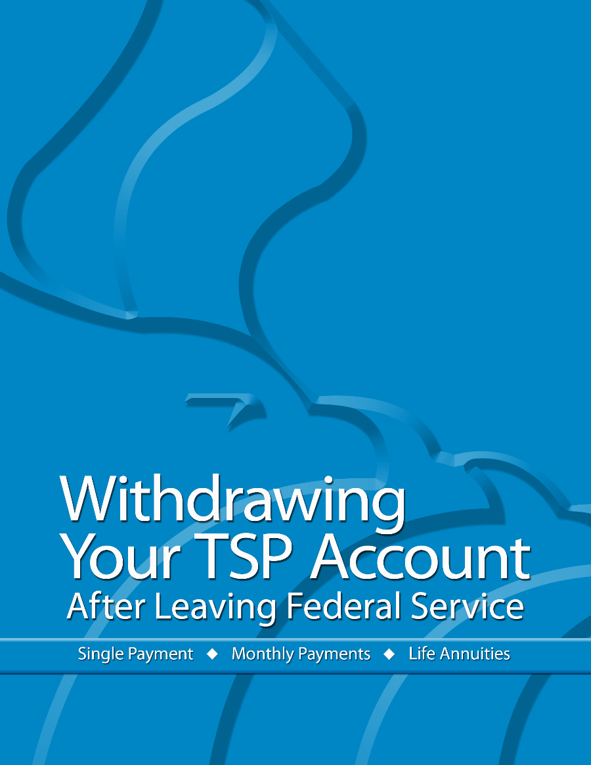
Thrift Savings Plan
Obtain a copy of the TSP booklet:
“Withdrawing Your TSP Account After Leaving Federal Service”
https://www.tsp.gov/PDF/formspubs/tspbk02.pdf
Notes:
http://apps.opm.gov/Listserv_Apps/list-sub.cfm

Slide 89
Social Security
To create your own social security account on-line, go here:
https://www.ssa.gov/myaccount/

Slide 90
Social Security Full Retirement
Age to Receive full Social Security Benefits:
Age Year of Birth
66 1943-1954
66 and 2 months 1955
66 and 4 months 1956
66 and 6 months 1957
66 and 8 months 1958
66 and 10 months 1959
67 1960 and after

Slide 91
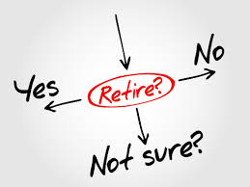
Social Security Early Retirement
You can get Social Security retirement benefits as early as age 62. However, Social Security will reduce your benefit if you retire before your full retirement age.
For example, if you retire at age 62, your benefit would be about 25 percent lower than it would be if you waited until you reach full retirement age.

Slide 92
Social Security Early Retirement
Earnings Offset
If you work and get benefits at the same time:
You can continue to work and still get retirement benefits. Your earnings in (or after) the month you reach your full retirement age won’t reduce your Social Security benefits. Social Security will reduce your benefits, however, if your earnings exceed certain limits for the months before you reach full retirement age.
Here is how it works:
If you’re younger than full retirement age, Social Security will deduct $1 in benefits for each $2 you earn above the annual limit ($19,560).
In the year you reach your full retirement age, Social Security will reduce your benefits $1 for every $3 you earn over an annual limit until the month you reach full retirement age. Once you reach full retirement age, you can keep working and your benefit won’t be reduced no matter how much you earn.
Notes:
https://www.ssa.gov/news/press/factsheets/colafacts2021.pdf
If you’re younger than full retirement age during all of 2021, Social Security deducts $1 from your benefits for each $2 you earn above $18,960.
If you reach full retirement age during 2021, Social Security deducts $1 from your benefits for each $3 you earn above $50,520 until the month you reach full retirement age.
Although the earnings offset limit is the same for the Special Annuity Supplement and Early Social Security benefits ($18,960 in 2021), the method of offset is not.
Special Annuity Supplement offsets are applied the year following a year of excess earnings.
Early Social Security benefits offsets are applied the same year as the excess earnings, based on estimates
If you work for someone else, only your wages count toward Social Security’s earnings limits.
If you’re self-employed, Social Security counts only your net earnings from self-employment.
For the earnings limits, Social Security does not count income such as other government benefits, investment earnings, interest, pensions, annuities, and capital gains.
Social Security Taxation https://www.ssa.gov/benefits/retirement/planner/taxes.html
If you file a federal tax return as an “individual,” and your combined income is between $25,000 and $34,000, you may have to pay taxes on up to 50 percent of your Social Security benefits. If your combined income is more than $34,000, up to 85 percent of your Social Security benefits may be taxable.
If you file a joint return, you may have to pay taxes on 50 percent of your benefits if you and your spouse have a combined income that is between $32,000 and $44,000. If your combined income is more than $44,000, up to 85 percent of your Social Security benefits may be taxable.
If you’re married and file a separate return, you probably will pay taxes on your benefits.

Slide 93
Social Security Early Retirement
Earnings Offset
Although the earnings offset limit is the same for the Special Annuity Supplement and Early Social Security benefits (currently $19,560), the method of offset is not.
Special Annuity Supplement offsets are applied the year following a year of excess earnings.
Early Social Security benefits offsets are applied the same year as the excess earnings, based on estimates.

Slide 94
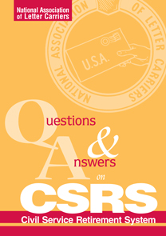
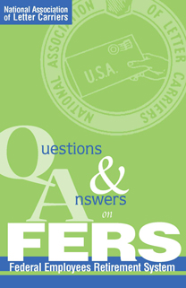
Go to www.nalc.org click on workplace issues click on retirement click on useful publications
Useful publications
Additional NALC retirement publications
These NALC retirement booklets and leaflets are available free to members. Contact the NALC Retirement Department for copies. See note of caution.
The publications are also available here in PDF format. Click on the booklet or leaflet to browse it online, right-click and save to download.
Questions & Answers on the Civil Service Retirement System
This NALC booklet covers Civil Service Retirement System retirement eligibility, credit for service, types of retirement, survivor elections, the Thrift Savings Plan, health and life insurance, and more.
Questions & Answers on the Federal Employees' Retirement System
Covers Federal Employees Retirement System retirement eligibility, credit for service, types of retirement, survivor elections, Social Security, the Thrift Savings Plan, health and life insurance, and more.
Survivor's Guide to CSRS, FERS, and Social Security
This booklet covers questions spouses or other survivors may have about death benefits. It applies to survivors under both the Civil Service Retirement System and the Federal Employees Retirement System.
Preparing for Retirement
As one starts preparing for retirement, the first question that usually comes to mind is when and where to begin the process.
Since there is a lot of information to absorb, many forms to be concerned with and quite a few decisions to make, all of this has been put into a framework of steps to follow in preparing for retirement.

Slide 95
Important Phone Numbers
USPS Shared Services: 877-477-3273 (option 5)
Branch 38 Director of Retirees: Ron Villegas
973-564-7244 Ext. 21
NBA: Bruce Didriksen 212-868-0284
NALC Retirement Dept: 202-393-4695
Toll free M-W-Th 10-12 & 2-4: 800-424-5186
Notes:
http://apps.opm.gov/Listserv_Apps/list-sub.cfm

Slide 96
Retirement -
The Golden Years?

Slide 97
Pros
No time clock
No scanning
No supervisors
No bad weather
No dogs
No schedule

Slide 98
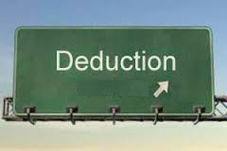
Cons
Income goes down
Deductions go up
Hospitalization
Insurance
Annuity

Slide 99
Cons
Loss of companionship and networking
Too much spare time - what to do?
Change can be difficult

Slide 100
Alternatives
Stay Active - walk, etc.
Get a part-time job -
increases income
Do volunteer work
Join an organization - Elks, K of C, Moose,
VFW, etc.

Slide 101
Alternatives
Develop a hobby -
Gardening
Golf
Bocci…..
Join a senior group -
ROMEOs
Red Hats

Slide 102
Main Concerns
Health
Hospitalization
5 years in Federal plan
Where to live - Should you move?
Medicare Part B

Slide 103
RETIREMENT
IT IS GREAT
But PREPARE for it!
It CAN BE the GOLDEN YEARS

Slide 105
IN MEMORY OF CHARLIE CONNELL October 4, 1934 – January 18, 2018

